Slide 1
Meet The Teacher
Pearl Class

Slide 2
Teacher: Mr Mukhopadhyay
Teaching Assistant: Mrs Keer

Slide 3
Reading
Little and often – e.g. books, labels, signs
Ask comprehension questions – e.g. why, what who, when, which,
Let your child make predictions
Talk about new words
Review the book/story
Write a comment in the reading record book
Library book is taken home once a week on a Friday.
Ensure that your child has his/her book bag daily
Encourage changing the reading book on the book changing days i.e. Monday and Thursday.
Teaching of reading is also done through shared, guided reading and phonics.
Children’s book levels may change based on both their comprehension and sight reading skills.

Slide 4

Bug Club
As little as 10 minutes per day will make a HUGE difference!!

Slide 5


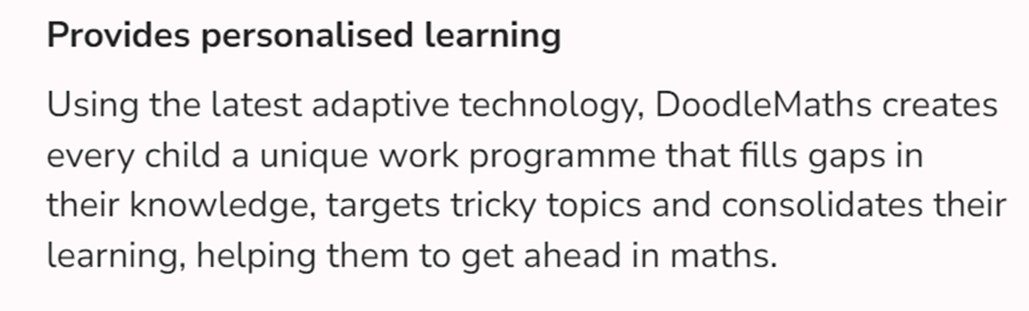
Online Platforms
01
02
Logins ‘should’ be in the Reading Record.
If a login is lost, I will ask the IT department for new logins, as it is the start of the year this may take a few days.

Slide 6

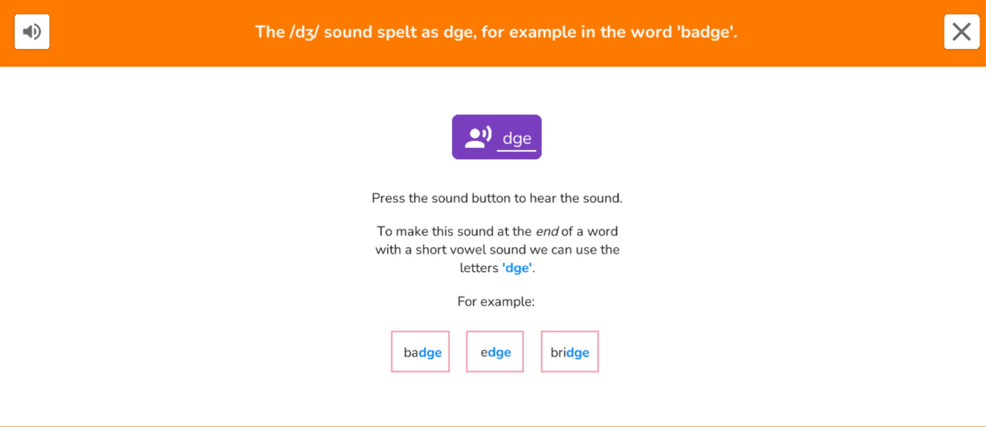
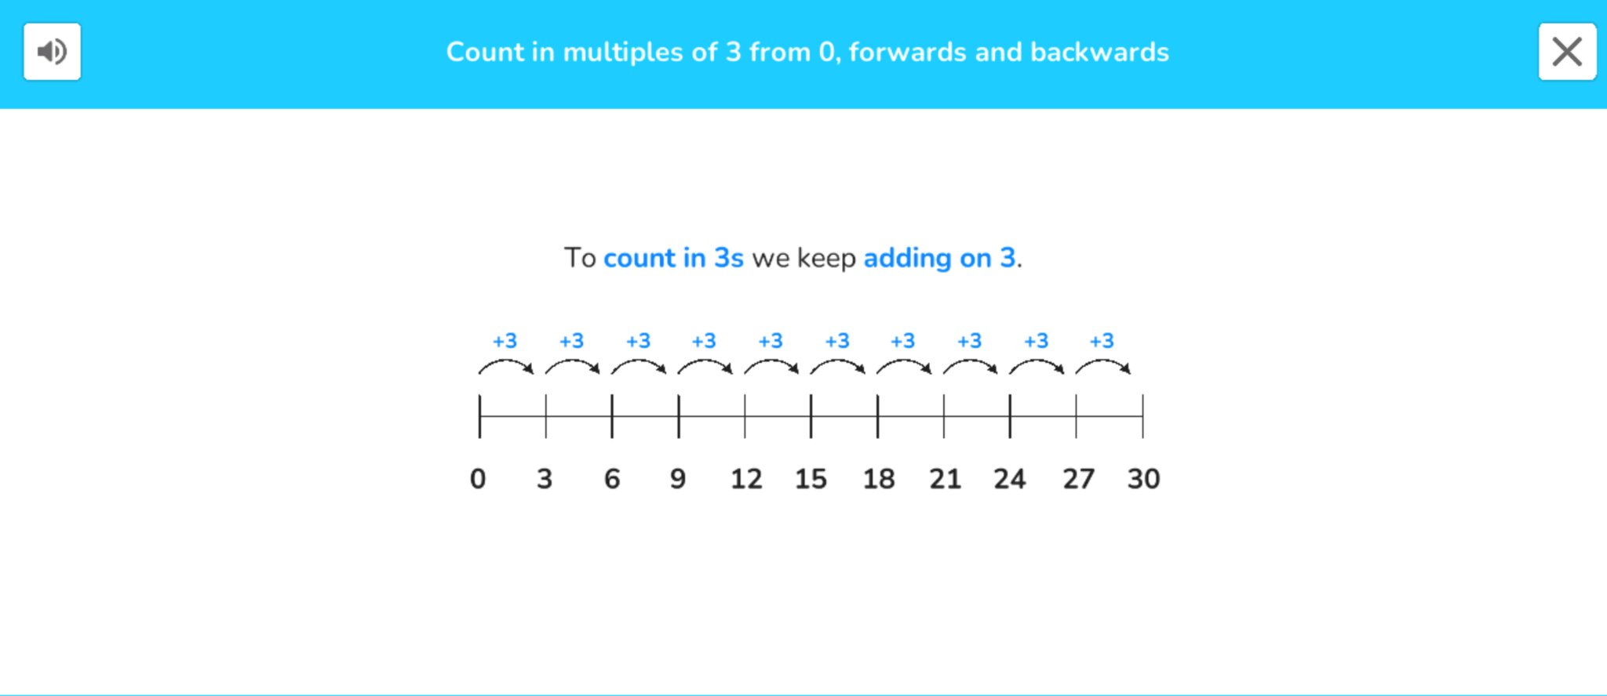
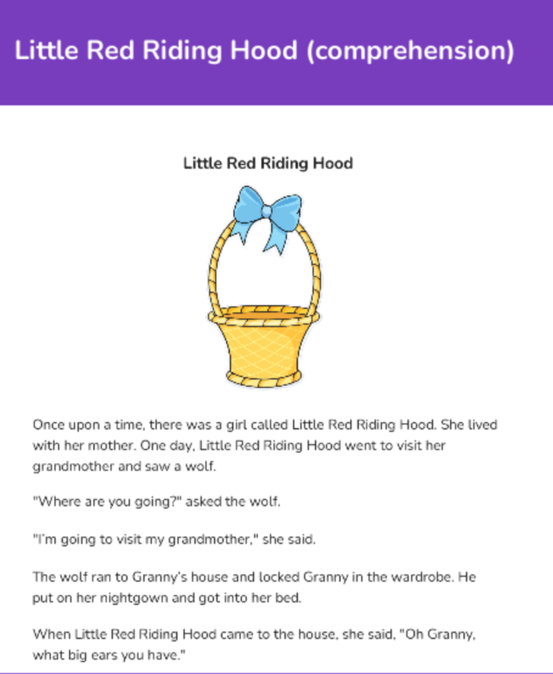
Examples of Doodle
Assessments
Doodle is a creative learning tool that covers the core areas of Maths and English.
It is a personalised learning experience tailored to the needs of every child - improving their confidence and ability.
This will be a homework program for your children to do independently 10 minutes daily.
Logs in for your child will be in their reading records today

Slide 7
Spellings
Spelling test is on Thursday of each week
All spelling tests are recorded in individual spelling books
Results recorded in reading record books
Encourage the Look, Say, Cover, Write, Check method
Children are to write full sentences using those spellings into their homework books.
Expectations are that the children will practise their spellings and know what they mean.
NN: Common exception words for Year 1 and Year 2.
High frequency words for Year 1 and 2.

Slide 8
Homework
Weekly
Discovery
Weekly homework is sent out on a Friday and due in the following Thursday to be marked.
The children that do not bring back their H/W will not be rewarded with golden time.
Please support the school by ensuring that your child does all the homework set and returns it by the recommended date.
Particularly ensure that reading is done regularly at home.
Once every half term
Related to topics – e.g. Healthy Choices, Florence Nightingale.
Several weeks to complete. The due date is always provided with the written outline of the task.
Use a range of resources. Please don’t rely solely on computerised work. We are encouraging children to develop their written and designing skills.
Drawings/ Photos/ Models

Slide 9
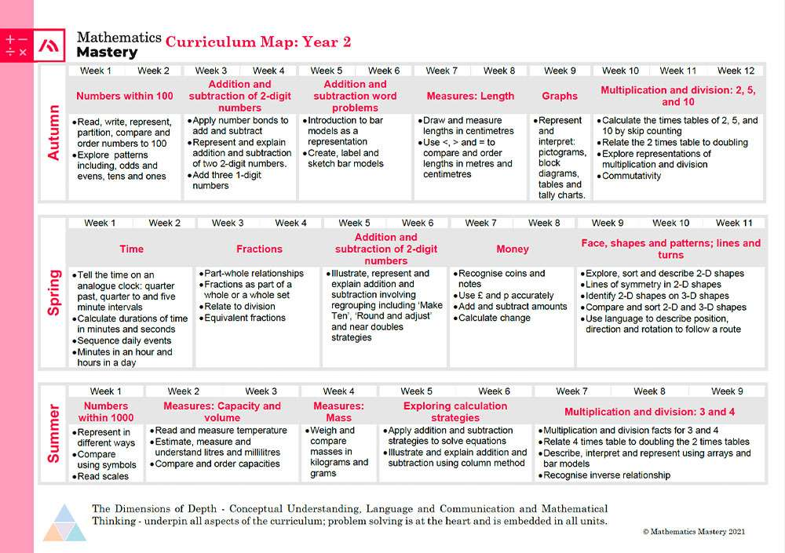

Slide 10
P.E
P.E days are Tuesdays and Fridays
P.E will be twice a week and children are to come in wearing their PE clothes.
Shorts and a T-shirt
Plimsolls/Trainers
Please ensure that ALL items are labelled.
NO earrings.
Please ensure that your child, if female, does not wear hard clips on these days.

Slide 11
Communication
Any important dates for your diary will be included in the weekly newsletter.
Notices will also be placed on the window/large whiteboard/class notice board.
Always feel welcome to make an appointment with the class teacher after school of any concerns or queries about your child.

Slide 12
Soft Starts
Tuesday (english focus) and Thursday (maths focus) Mornings
Weekly activities
Sun
Mon
Tue
Wed
Thu
Fri
Sat
09:00
Fantatsic opportunity to learn about what we teach in class.
10:00
1
2
3
4
5
11:00
6
7
8
9
10
11
12
12:00
13:00
A great time to recieve messages about any upcoming events.
13
14
15
16
17
18
19
14:00
15:00
20
21
22
23
24
25
26
All welcome!
16:00
27
28
29
30
31
17:00

Slide 13
Attendance
An important issue – children who succeed at school are those who attend.
Punctuality is important – it is unsettling when their peers are altogether involved and they are just arriving.(all children to be in at 8.45am)
No child is allowed to take time off during term time.
Please make an appointment to see the Head teacher if you need time out of school holidays
Always keep in touch and let us know why your child is away.
Classes will be rewarded with a non-uniform day for 100% attendance.

Slide 14
School Meals
Please inform the school of any allergies or dietary requirements.
Please support you children at home with correct use of cutlery.
Make sure your child brings a labelled water bottle daily.
Any donation towards buying cooking ingredients is welcomed.
Please donate some tissues and wet wipes for the class.

Slide 15
Administration
Please ensure when you send in money you clearly mark the envelope with the name, amount and reason for payment.
Please send in the correct amount.
Also when returning forms, please fill out all the details including signatures and dates if required.

Slide 16
Mobiles
No mobile phones on the school premises.
Turn them off while you are here.
When collecting and dropping off your child please be attentive.

Slide 17
Birthdays and Special Occasions
Please note that for birthdays and special occasions children can donate a book to the class library.
Due to allergies and food intolerances we are not able to give out sweets or cake in the classroom. (You could bring fruits that we don’t provide such as seedless grapes or strawberries )
We are also not able to give out class name lists.
A reminder that we are a Allergy free school.

Slide 18
How can you help?
Join our team of school governor.
Volunteer to help in the classroom (listening to readers, changing books).
Do you have a special interest/expertise such as gardening, cooking, ICT?

Slide 19
Expectations and Gentle Reminders
Encourage your child to always do his/her best, both in work and behaviour.
Please do not let your children play in the Reception playground before school.
Please dismount bikes and scooters by the entrance gate.

Slide 20


Yeading Infant & Nursery School
OPAL Play

Slide 21
What is OPAL Play?
Outdoor Play And Learning
Building friendships
Driven by the children
Managing Risk
Learning Through Play
Free Play
Fun

Slide 22
Significant impact on…
Behaviour - happy children – 20% of school is playtime.
Accidents - OPAL schools have up to 80% less reported accidents due to managing risk.
Self-regulation - learn to self regulate through practice, trust and freedom.
Physical activity - significantly more active.
Mental well-being - children are happier.
Social and emotional development - Good play is where relationships are practiced.

Slide 23
Links to formal learning - increased creativity, imagination and collaborative skills
Attendance - children can't wait to come to OPAL schools because they have such fun
Parents - are happier
Rights - Play is a child's right as recognized by the UN Convention on the Rights of the Child
OFSTED - OPAL schools can easily provide evidence on their approach to wellbeing and inclusion
Risk - OPAL schools report significant improvements in children's ability to identify and manage risk

Slide 24
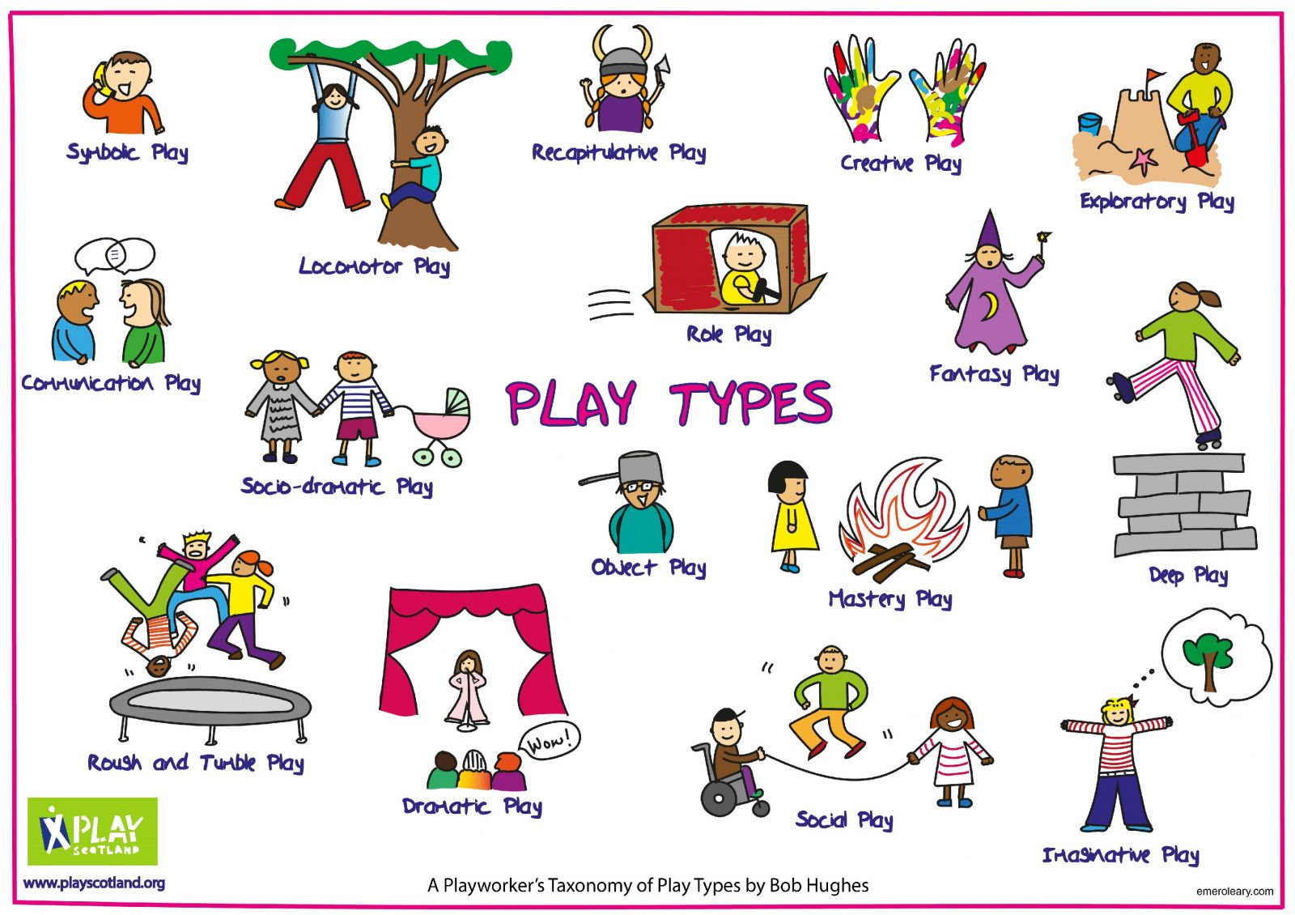

Slide 25
Get Involved
Please bring wellies for your child to keep at school – clearly labelled.
Please bring waterproof clothing – clearly labelled.
We kindly ask for any donations – in good, clean condition
Such as old wellies, dressing up clothes, small world items etc
The children love to play in all weather.

Slide 26
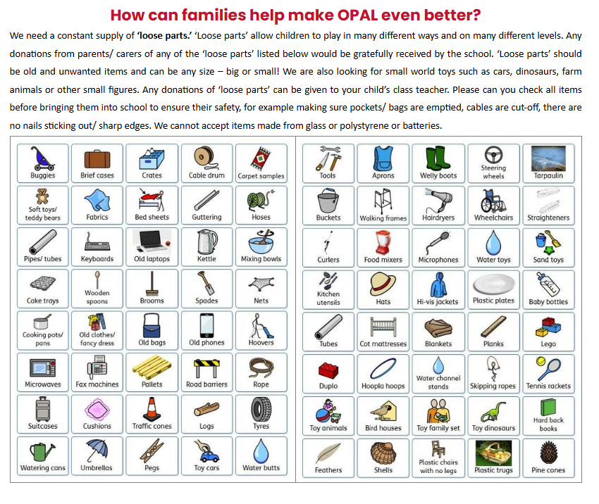


Slide 27
Class Information
We are looking for an OPAL Play Parent champion to support the school. See Mrs. Loi for more information.
We are looking for an OPAL Play Governor to support the school. See Mrs. Ahluwalia for more information.
Bring in donations for the school – see list
Any handy parents that can help with building and creating fantastic ideas. See Mrs. Loi

Slide 28
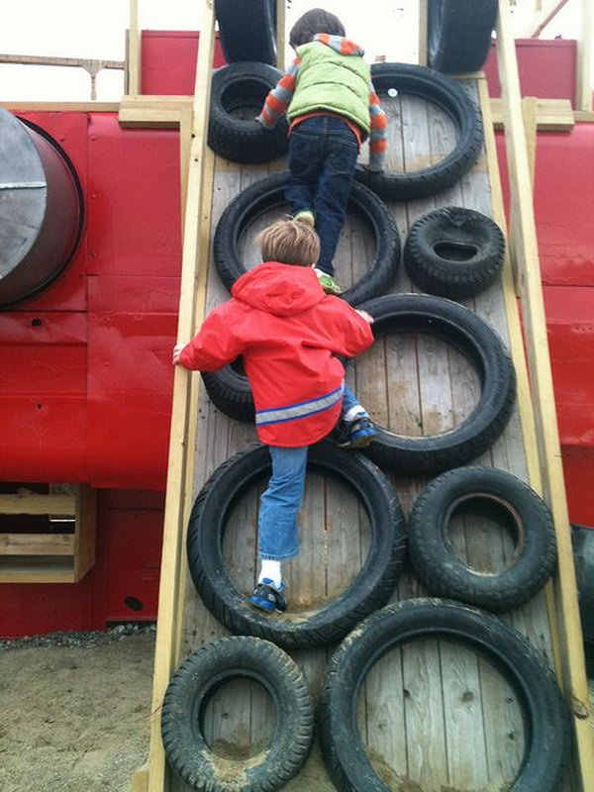
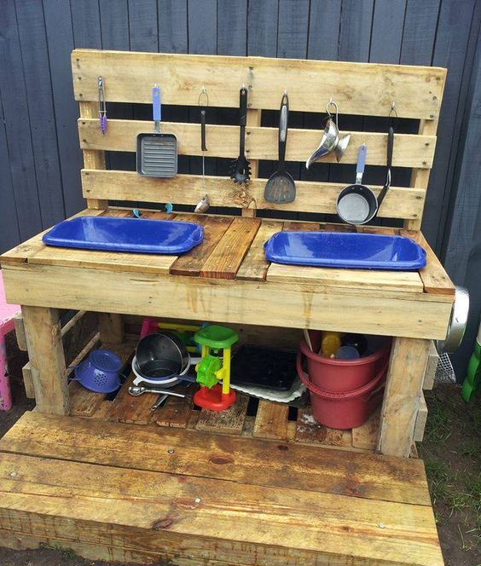
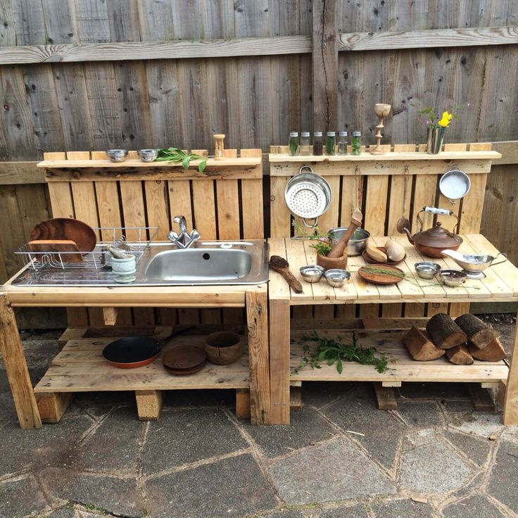
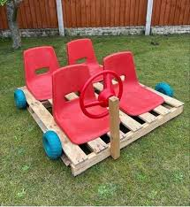
Can you Help?
We are looking for help with building resources.

Slide 29

Play Charter
Be Kind
We show compassion for all.
Be Friendly
We include everyone.
Be Safe
We look after everyone and the equipment.

Slide 30
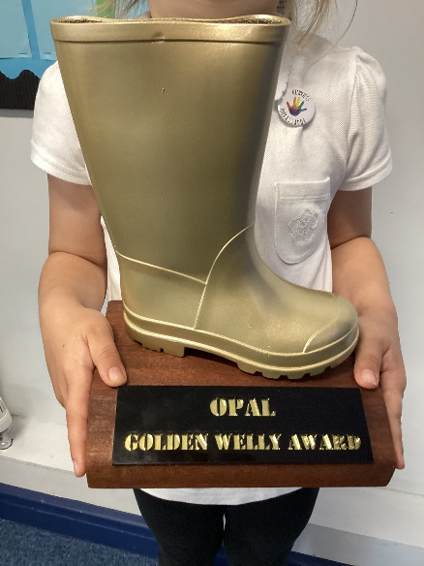

Awards
Golden Welly
To celebrate children and their amazing play.
You can achieve this award for using your initiative
during play, having outstanding behaviour,
being a kind friend or showing good sportspersonship.
Golden Broom
For children who demonstrate outstanding attitudes
towards tidying up and caring for the
school environment and its resources.

Slide 31

New Maths Scheme – 1 year in

Slide 32


Slide 33
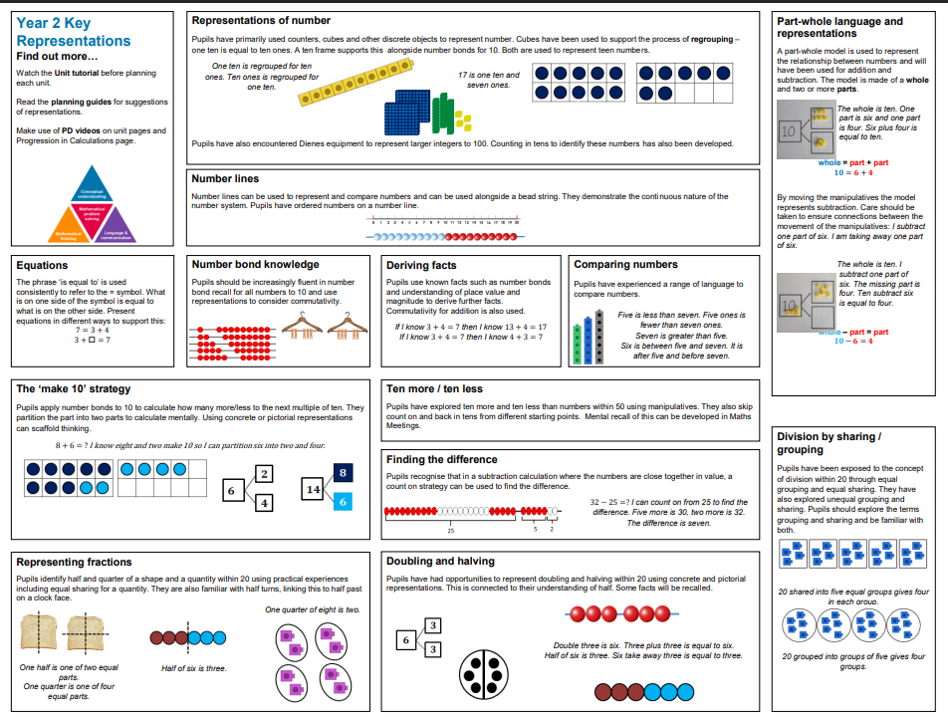

Slide 34
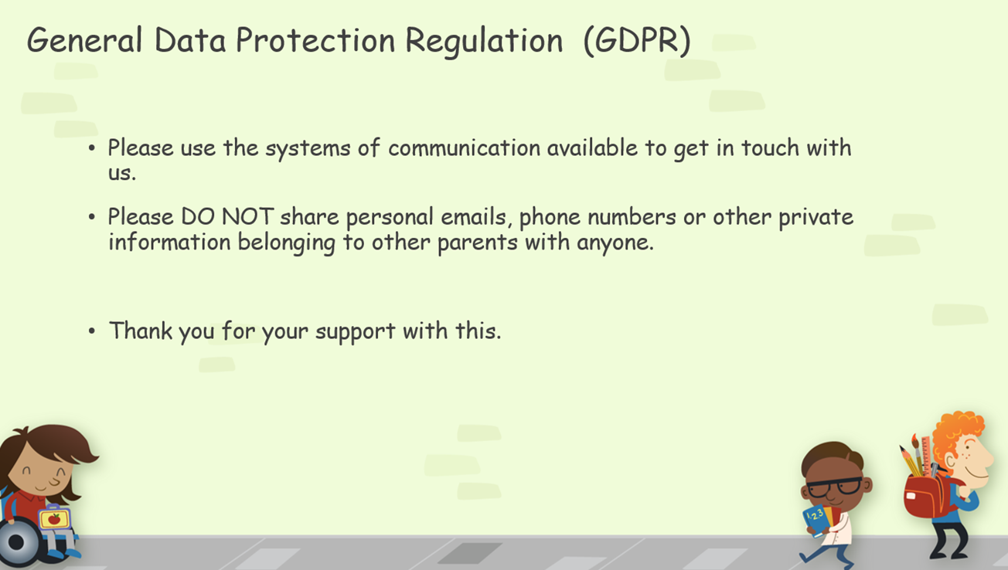

Slide 35
Lateness for collection
If you are late to pick up your child (after 3:20) your child will be put into wrap around care. This will cost £4.50. They can stay until 4:30.

Slide 36
Thank you for coming and for your continued support!
Questions?

