Slide 1

Meet the Teacher
Tigger class
September 2026
Class Staff
Teacher – Ms Kaur
Teaching Assistant- Mrs Leggett

Slide 2

School Uniform
PE – Spring Term only
Boys and girls
Navy T-shirt with school logo
Navy shorts or navy jogging bottoms
Black plimsolls
Pe will not take place until January 2027
for Reception
ALL NAMED PLEASE.
Boys – Navy jumper with school logo
      Grey trousers
      Black shoes – no trainers.
Girls – Navy jumper with school logo
Grey trousers/skirt/pinafore – with grey tights
Black shoes
No coloured hair accessories and large earrings.
Please no shaved hair patterns. Hijabs to be in school colours.
ALL UNIFORM ITEMS TO BE NAMED.

Slide 3
Times
Morning doors open 8.45am.
School finishes 3.10pm Inform the teacher of other parents/guardians picking up your child.
If late, let the Office know. Your child will be taken to the office and a charge of £4.50 will incur from 3:30.
Any appointments let the teacher know first, then office staff.
Absence – ring Absence Hotline via school number in morning.
Any allergies or medication – notify the office.
ATTENDANCE – Needs to be at or above 97%.

Slide 4
School Dinners
Already started on 9th September
All children eat school dinners
School Dinners are free
Very healthy
Meat/vegetarian – teachers will have a list to split the children into the correct group
Children need to be able to eat with fork or spoon, and ideally a knife

Slide 5

Please inform the school office if you as a parent have any allergies.

Slide 6
Forest School
One half term in the school year, your child’s class will attend Forest School. I will update you on the dates.
You will need to complete a medical form for your child to take part. Please take a form before you leave today.
Your child will also need wellington boots, preferably one size larger than their actual shoe size. All boots to be labelled with name and class please.
Cooking
Please could you help us with £1 donations every term for cooking.

Slide 7
General
Names - recognition
Reading – Read with your child every day. Please write a comment in their reading log book or provide initials to show the book has been read at home. Ensure your child brings their book folder every day.
Additionally, we have a online resource called Bug Club & Rhino readers, which provides more books to read. Login information will be provided in your Reading Record Book.
Practise number work – for example, counting objects, recognising and writing numbers to 10;
handwriting – initially in print, then cursive style;
Phonics knowing letter names and sounds.
Our weekly newsletter is packed full of ideas and information about current themes and activities in the classroom. Please read and support your child with any homework suggestions.

Slide 8
Admin.
When returning forms, please fill out all the details including signatures and dates when required. Cross out the appropriate choice eg I agree / I do not agree
Please ensure when you send in money you clearly mark the envelope with the name, amount and reason for payment.
Please send in the correct amount as giving change will be problematic.

Slide 9
Final Important Points / Reminders
You are very welcome to call the school office to make an appointment to see the class teacher. Brief information can be passed over at the class door.
Please avoid Tuesday after school as the staff have their school meetings.
Please at the start and end of the day ensure that younger siblings do not play with any of the playground equipment outside. Many thanks.

Slide 10

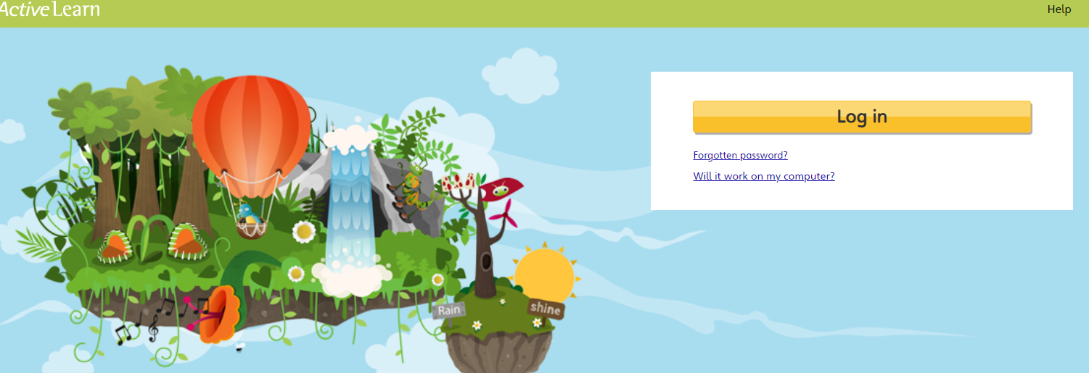


Subscription website provided for our pupils
Bug club

Slide 11
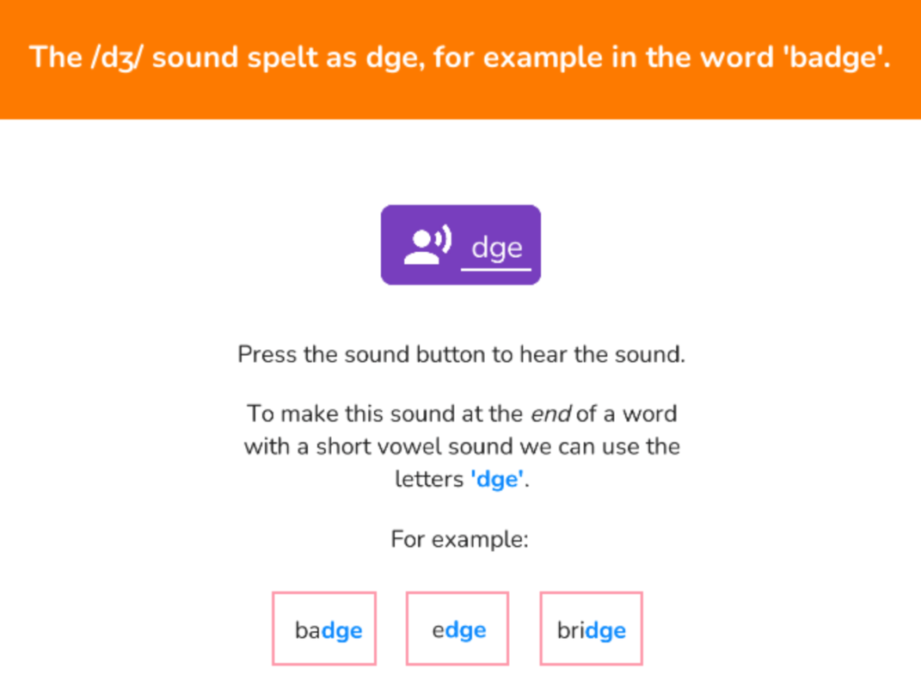
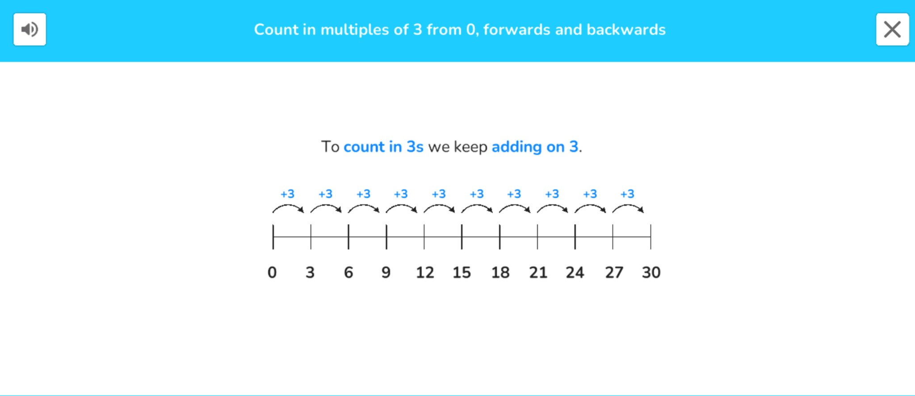
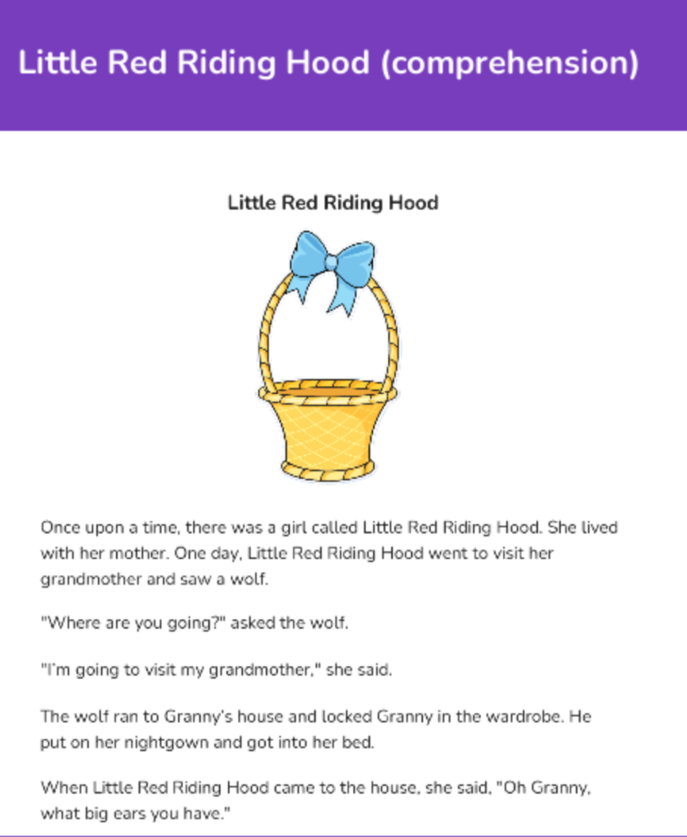
Examples of Doodle
Assessments
Doodle is a creative learning tool that covers the core areas of Maths and English.
It is a personalised learning experience tailored to the needs of every child - improving their confidence and ability.
This will be a homework program for your children to do independently 10 minutes daily.
Logs in for your child will be in their reading records.

Slide 12
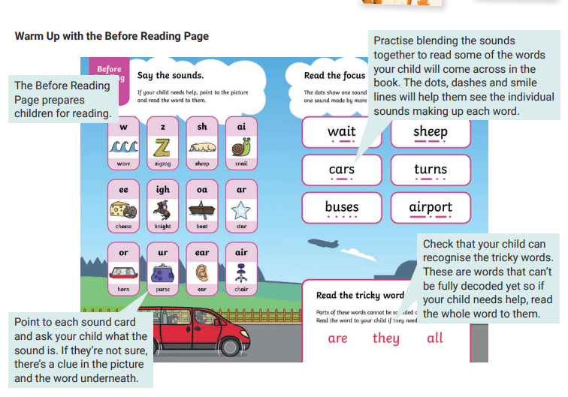
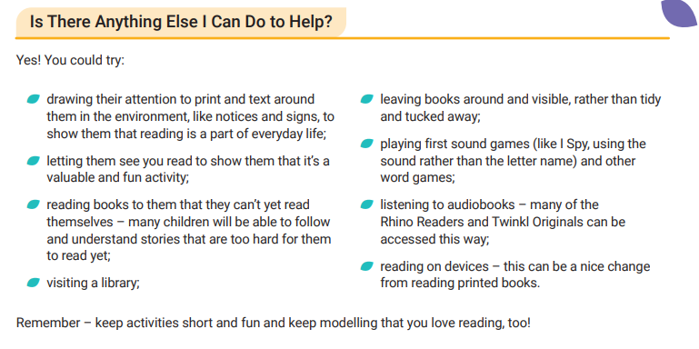

Slide 13
Family Learning courses provided by Hillingdon
Please look out for these in newsletters and text messages provided by the school.
These are extremely useful and support you in helping your children with their learning at home. In most cases they will take place online.
Soft Start
On Mondays and Wednesdays we will be inviting parents and carers into the classroom to spend some time reading, writing and doing number with their children. During this time I will be sharing important learning strategies and answering any questions you may have. I will not be able to provide a report on your child’s progress at this time.
During this time, phones are not allowed to be used in the classroom.

Slide 14
General Data Protection Regulation (GDPR)
Please use the systems of communication available to get in touch with us.
Please DO NOT share personal emails, phone numbers or other private information belonging to other parents with anyone.
Thank you for your support with this.

Slide 15
Coming up:
Reception Curriculum meeting (To be confirmed)
Thank you for listening.
Are there any questions?

