Slide 1
Welcome to our
Reception Curriculum Meeting
Important information
Assessment in Reception
Curriculum areas
Questionnaire sent out after this meeting

Slide 2


See timetable for all 0-5 years services on website.

Slide 3
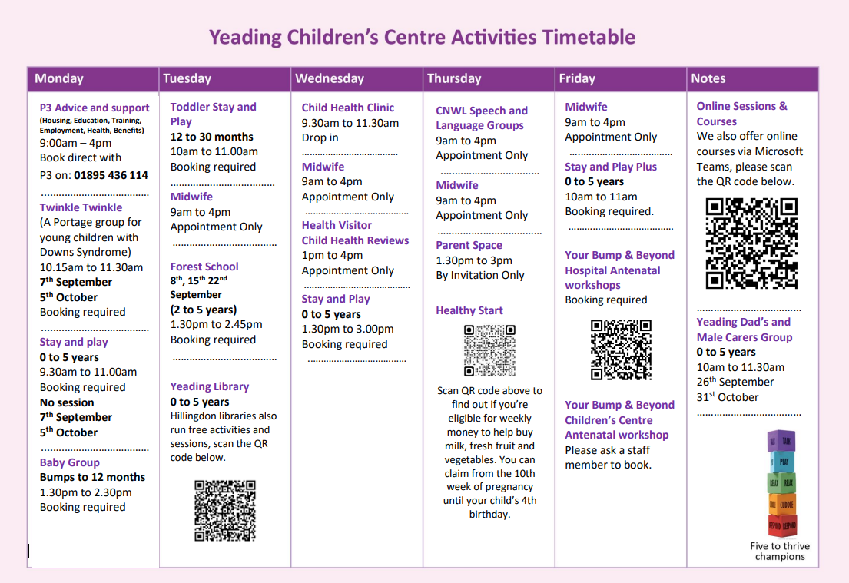

Slide 4


Penalty Notices
Lateness
Appointments
Children need to be in the class at 8:55am.

Slide 5

No phones in school premises
Allergy aware school
Scooters and Bicycles
GDPR (no photos of classroom or children)
Birthday Books
Hijab and Patkas – Blue only
No party hair pins and bands
Waterproof coats
Wellington boots
PE kits (January)

Slide 6
Healthy Lunches
Eat better, Do better
Fresh vegetables straight from our garden – at least two servings
Meat (chicken) and fish choices
Cater for vegetarians
Bread and salad
Healthy drinks
No deep frying, no processed meats or savoury snacks

Slide 7
Safe Routes to School
Parking on Carlyon Road
No walking or cycling through the school car park, nor the school playgrounds.

Slide 8
Websites
http://www.topmarks.co.uk/
http://www.literactive.com
Reading website:
www.oxfordowl.co.uk
Parents/Carers must register to use this website
Bug club https://www.activelearnprimary.co.uk/login?c=0

Slide 9
Assessment in Reception
Working in greater depth/ Exceeding
Using and applying knowledge, skills or understanding across the curriculum
Working At/ Expected (2)
Secure in their understanding within the context of teaching
Working Towards/ Emerging (1)
Increasing understanding
Working Below
Just starting to learn knowledge or skill
Reception Baseline within 6 weeks

Slide 10
Reception Curriculum
7 areas of the Early Years curriculum:
Prime
- Communication and Language
- Personal, Social and Emotional Development
- Physical Development
Specific
- Literacy
- Mathematics
- Understanding of the World
- Expressive Arts and Design

Slide 11
Currculum map

Slide 12
Personal, Social and Emotional Development
1. Making Relationships
Children play group games with rules.
Board games with family, games in the park, taking turns and waiting for a go.
They understand someone else’s point of view can be different from theirs.
Talk about different choices in food, play etc.
They can begin to resolve minor disagreements.
Let your child do the talking, become more independent.

Slide 13
Continued…
2. Understanding emotions
Children will begin to learn ways to manage their feelings and ways to maintain control.
What to do when they are angry or upset, talk them through it when you are at home, and tell them how you feel.
They should be able to listen to each other’s suggestions.
Taking turns in conversation.
They are able to stand up for themselves.
Encourage children to tell teachers if something has happened, if they don’t like something teach them what to say.

Slide 14
Continued…
3. Sense of Self: Self confidence and Self awareness
Children should be confident to speak to the class or a group.
They should be resourceful in finding support when they need help or information.
If they find something difficult, let them have a go first and then show them.
They should be able to talk about their plans and how they are going to carry it out.
Talk to them about what they are doing when playing at home, play with them.

Slide 15
Physical Development
1. Health and Self care
Personal hygiene
Washing hands, blowing their nose
Healthy eating
Know what is good for our body, eat lots of DIFFERENT fruit and vegetables at home.
Exercise
Keeping safe while running and climbing.
Dressing and undressing independently

Slide 16
Physical Development
2. Moving and Handling
Provide opportunities to be active indoors and outdoors
Confidence building, balancing, apparatus
Let the children be independent on climbing frames
Small and large movement
Hand and eye co-ordination- scissors, beading
Handwriting- play dough, painting, chopping, squeezing
Movement to music

Slide 17
Communication and Language
Build relationships
Lots of opportunities to interact with others
Engaging all their senses
Listening and attention
Tell the children about stories when you were young or about your day, get them to finish tasks (e.g. finish painting before going out)
2. Understanding
Ask ‘why’ and ‘how’ questions, listen to and give instructions, hear stories without pictures.
3. Speaking
Talking and responding to your child as much as you can, ask them lots of questions, showing them how to answer using full sentences. Make up new stories.
ALL OF THIS IS STRONGLY LINKED TO READING AND WRITING

Slide 18
Literacy
Phonics
Reading
Writing

Slide 19
Twinkl Phonics
Phase 2
s, a, t, p
i, n, m, d
g, o, c, k
ck, e, u, r
h, b, f, ff, l, ll, ss
Some examples of blending:
s-a-t sat
m-a-t mat
p-a-t pat
Sequence of teaching:
Revisit and review
Teach
Practise
Apply
Phase 3
j, v, w, x
y, z, zz, qu
Graphemes: ch, sh, th, ng, ai, ee, igh, oa, oo, ar, or, ur, ow, oi, ear, air, ure, er
Phase 4
CVCC words (e.g. t-e-n-t) and CCVC words
(s-p-o-t)
Additional tricky words e.g. was, you

Slide 20
Reading
READ EVERYDAY! Daily opportunities
Shared and group or guided reading
Individual reading
Plan an environment rich in signs and symbols
Reading at home – children will have an opportunity to change their books regularly following reading their book at home.
Note: It is important in the early stages that children become familiar with a book so that they can understand what they have read and begin to match what they have said with the written word. Children are encouraged to read a book at least 2 or 3 times.
Please add a comment in their yellow reading record book.

Slide 21
Ways you can help with Reading
Read stories at home.
Look at print in the environment.
Talk about pictures in the books they bring home.
Play letter and word games.
Let them see you read.
Spend 10 minutes most days sharing a book.
Visit the local library.
Read Bedtime stories.
Sing nursery rhymes.

Slide 22
Writing
Allow children to see adults writing (strong modelling roles) and encourage children to experiment with writing for themselves.
Provide a variety of writing and mark-making tools.
Allow opportunities for purposeful writing.
Be positive with your child’s efforts.

Slide 23
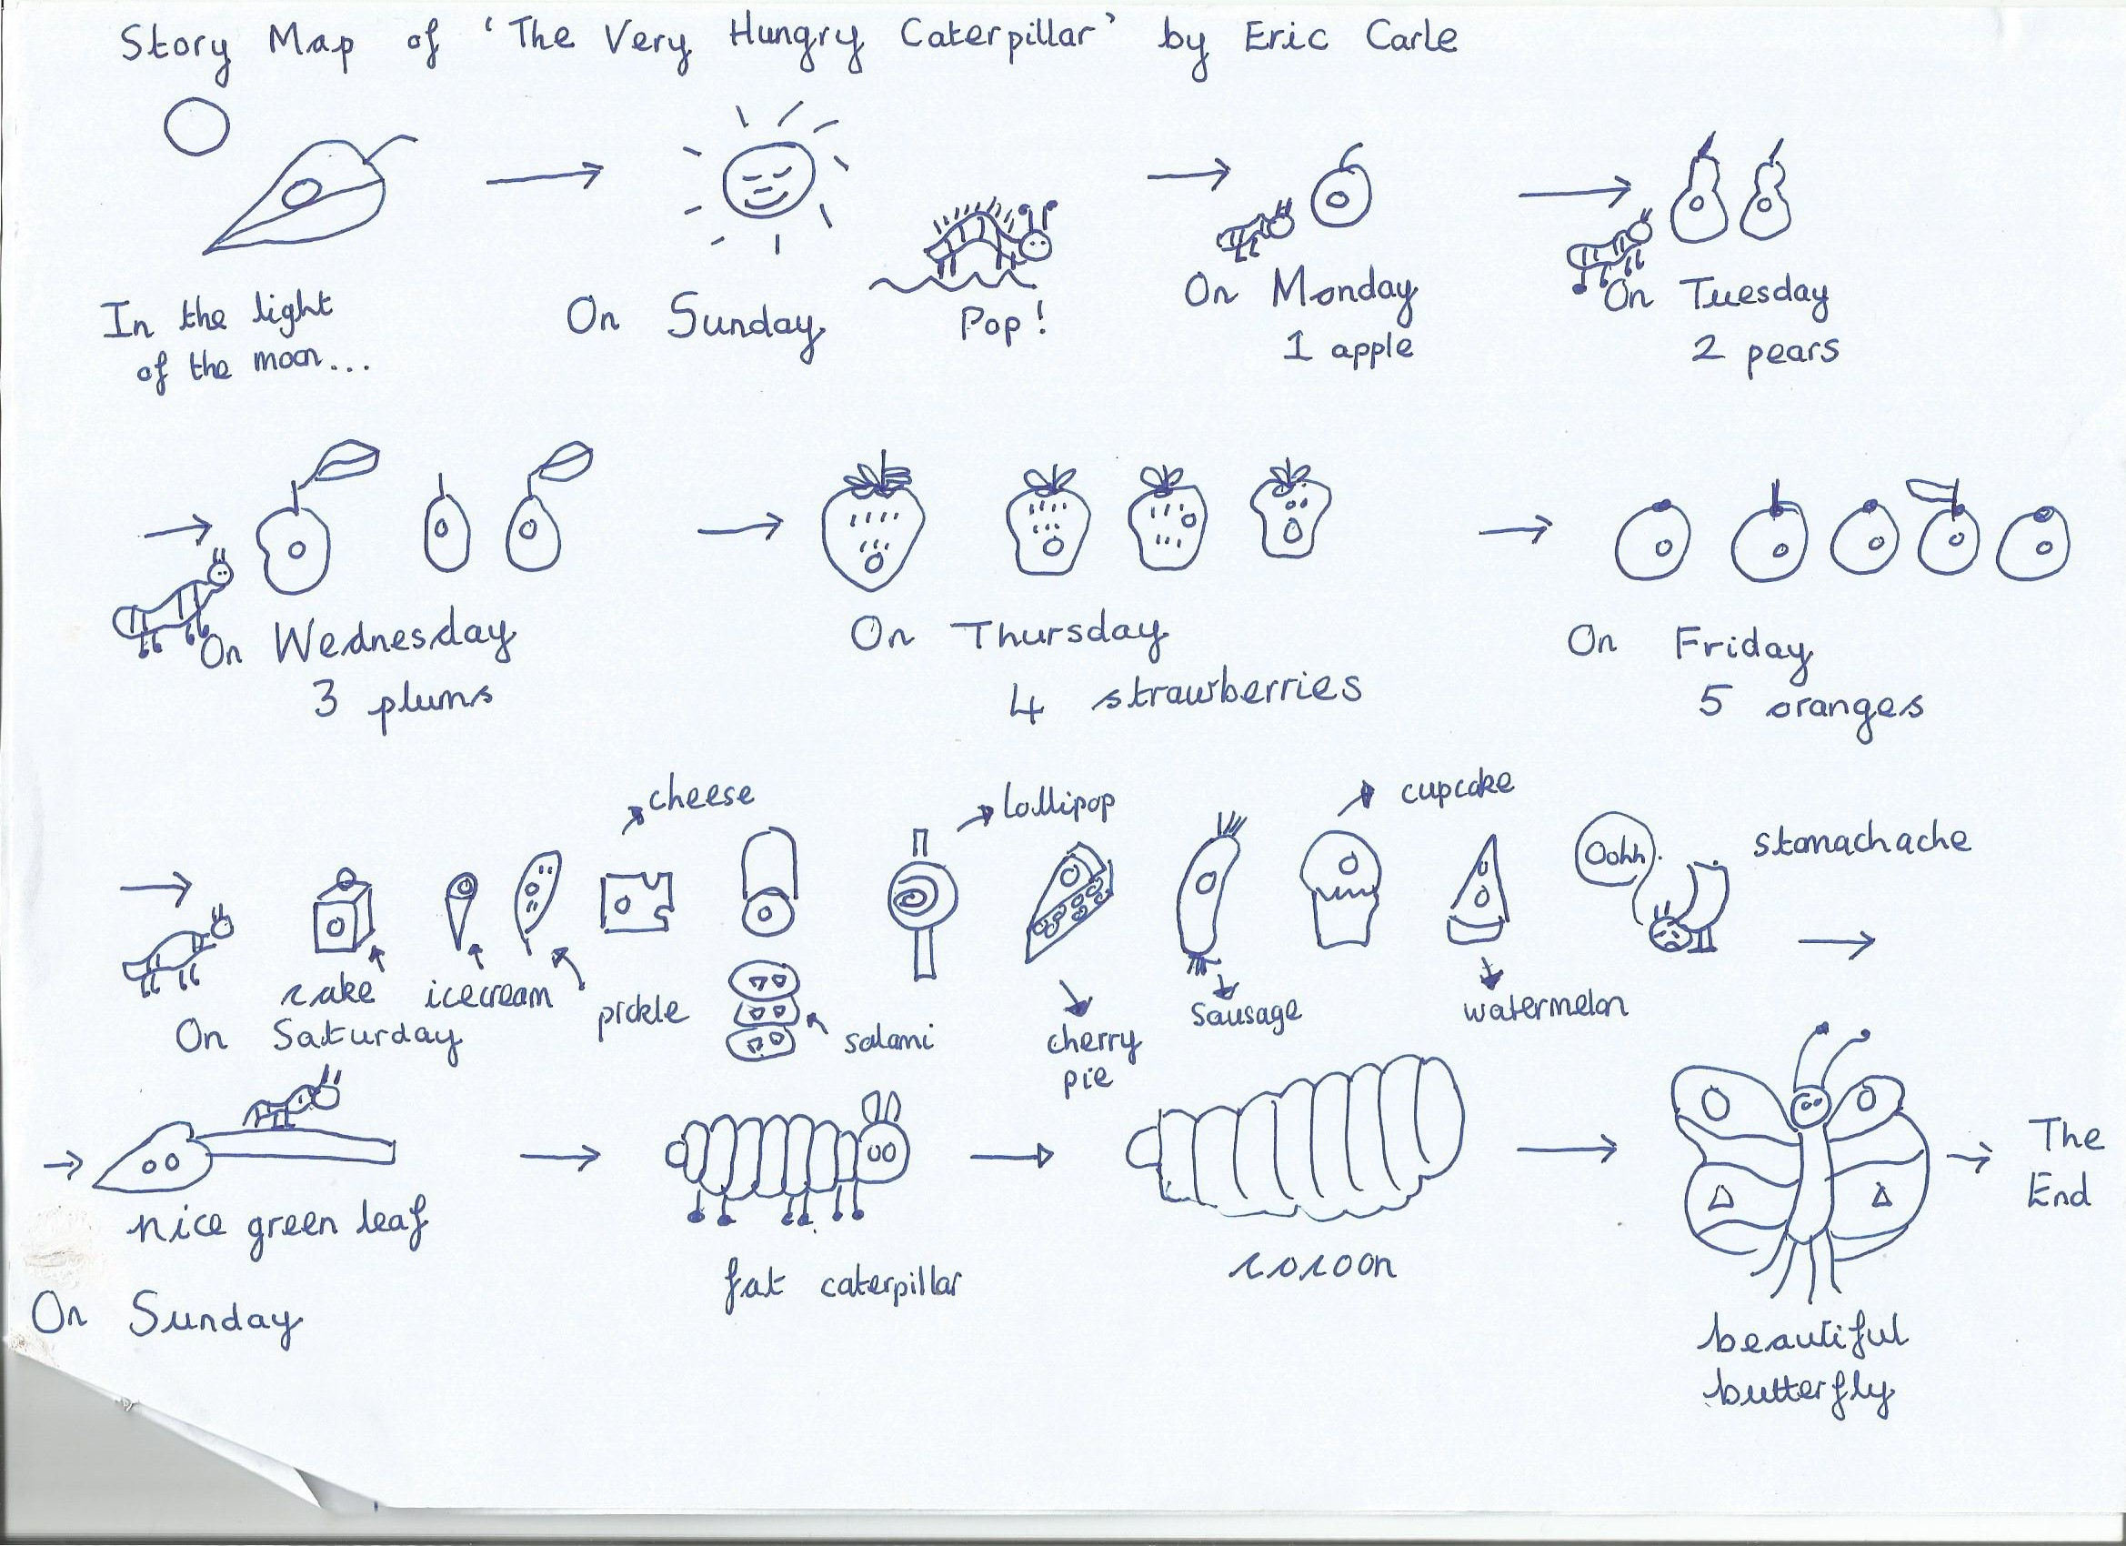

Slide 24
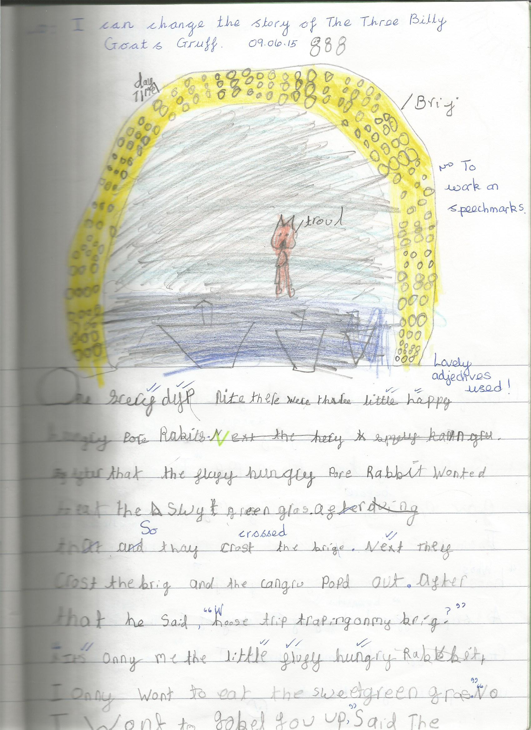
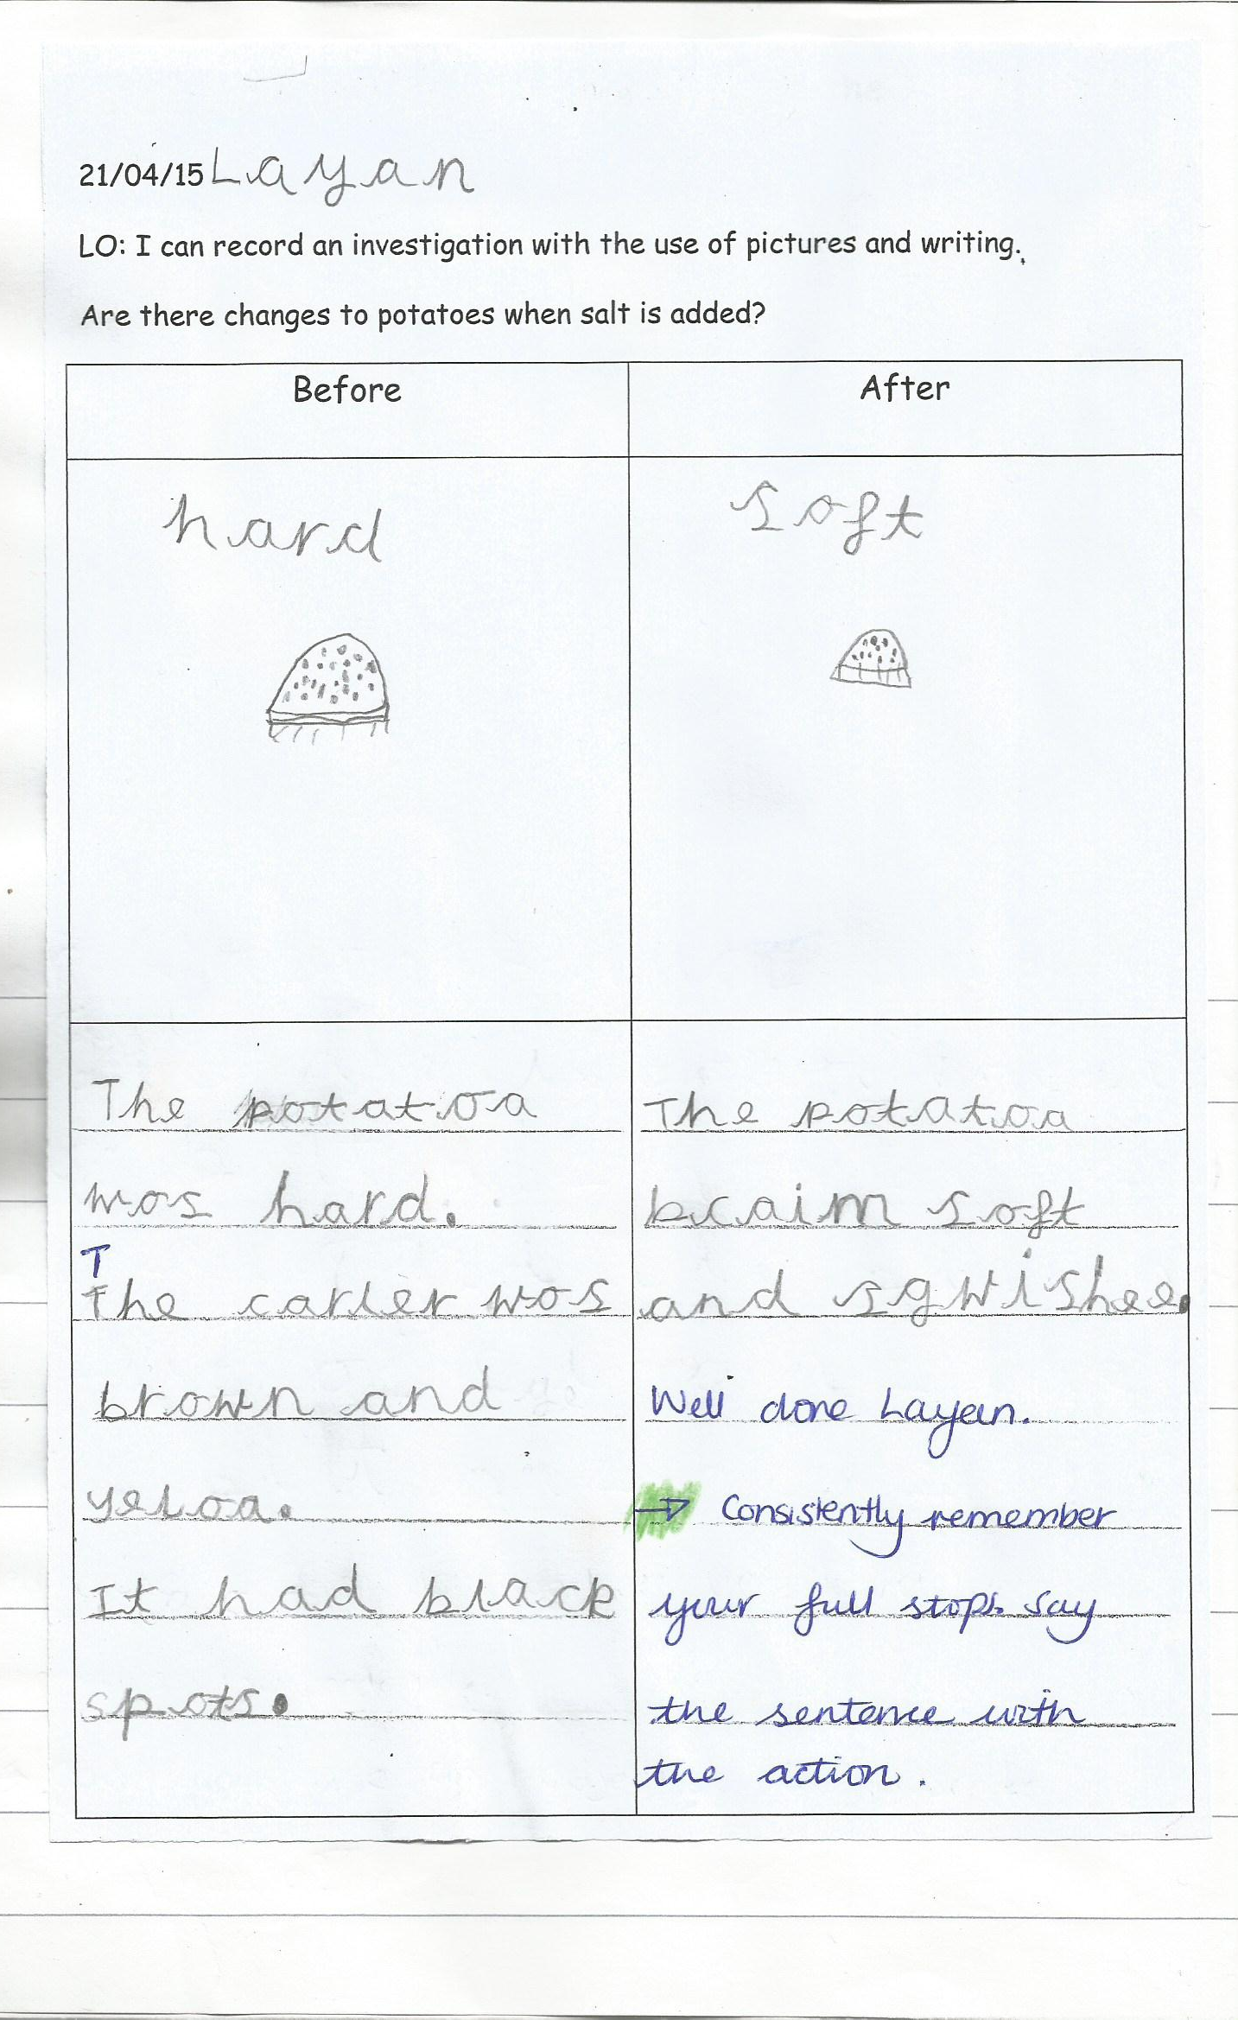

Slide 25
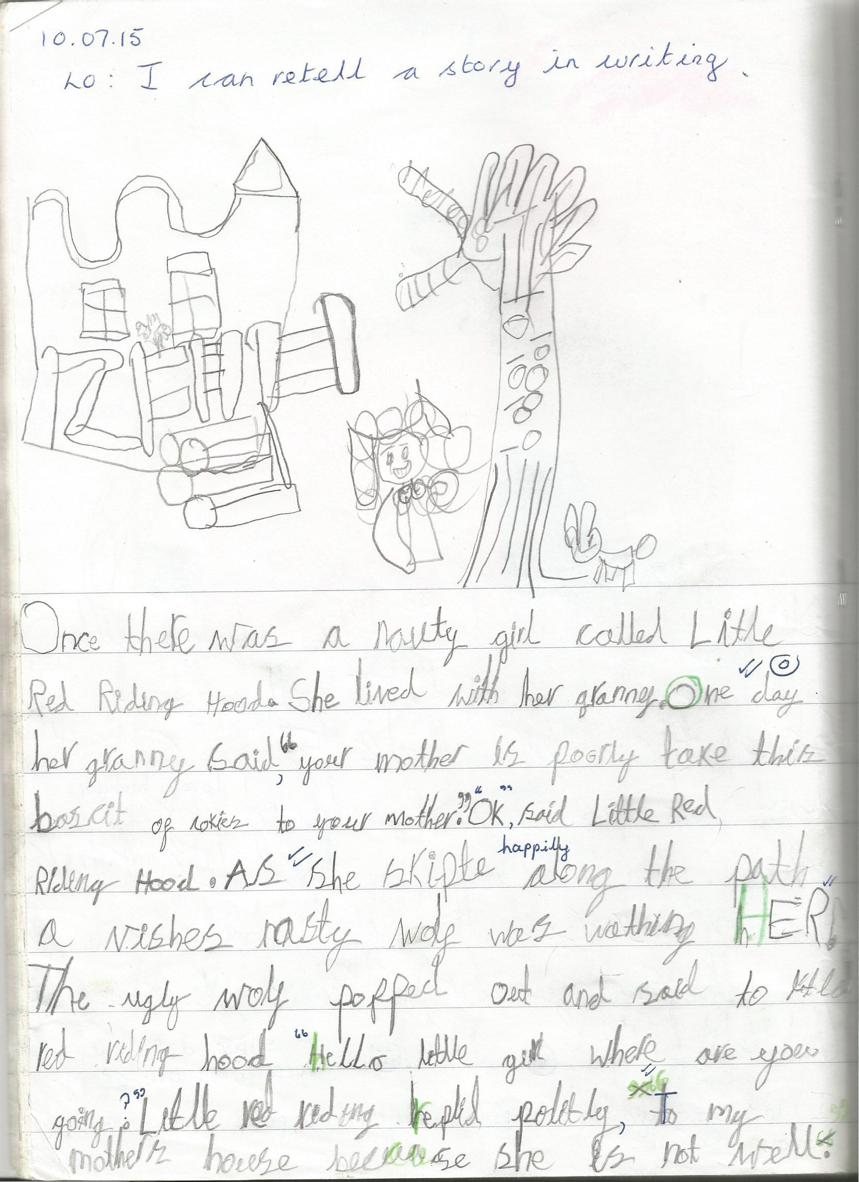

Slide 26
How children learn
Writing sounds
Writing words
Writing captions
Writing simple sentences

Slide 27
Maths Mastery in EYFS
This approach enables the pupils to gain a deep understanding of maths, allowing them to acquire a secure and long-term understanding of maths that allows them to make continual progress to move onto more complex topics.
The lessons are taught by breaking down maths objectives into the smallest steps, so that every pupil is secure in every new concept before moving on. The focus is on teaching for fluency, reasoning and problem solving.

Slide 28
Two main maths areas are: Number and Shape, Space and Measure
By the end of the Reception year, children are expected …
Number
-To count reliably with numbers from one to 20.
-To place numbers to 20 in order and say which number is one more or one less than a given number.
-Using quantities and objects, to add and subtract two single-digit numbers and count on or back to find the answer.
-To solve problems, including doubling, halving and sharing.

Slide 29
Shape, Space and Measure
-To use everyday language to talk about size, weight, capacity, position, distance, time and money.
-To compare quantities and objects and to solve problems.
-To recognise, create and describe patterns.
- To explore characteristics of everyday objects and shapes and use mathematical language to describe them.

Slide 30
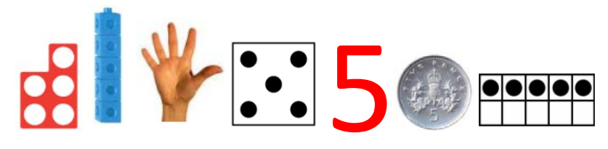
Fluency- deep understanding of number.
Representing Numbers
Children need to understand that numbers can be represented in many ways, not just as a written numeral. We use many different objects and pictures to show that numbers can be represented in lots of ways.

Slide 31
Fluency- deep understanding of number.
Counting
When counting, children need to understand…
• That we need to say one number for each object counted (touch counting).
• The final number we say is how many altogether. Some children continue to count after they have reached the final object as they don’t connect the numbers they are saying to the objects in front of them.
• That we can count objects in any order and the total stays the same.

Slide 32


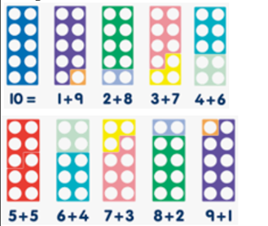
numicons

Slide 33
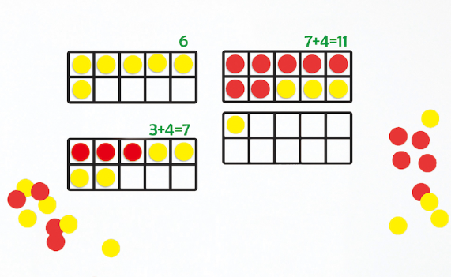
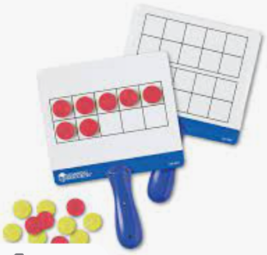
ten frames

Slide 34
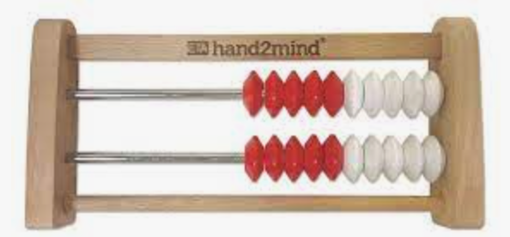
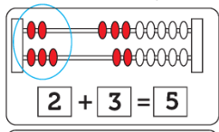
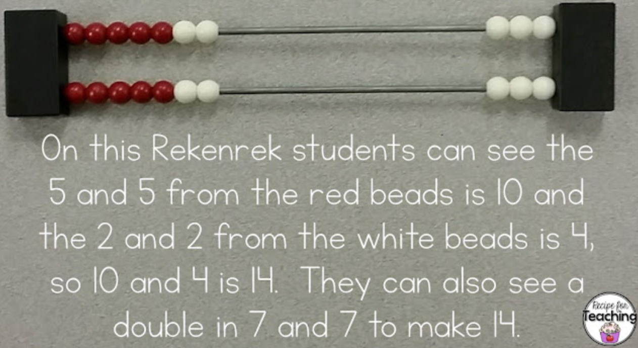
rekenrek

Slide 35

Subitising- recognising amounts.
Important skill to recognise small amounts without the need to count them. Initially this should be by using concrete objects but as children progress, allowing them to see groups of dots in different arrangements helps them to mentally ‘see’ how many objects are there without needing to count. This is a very important skill when children begin to add and subtract. Using dice is a good way to practise this skill before moving onto objects in different arrangements.

Slide 36
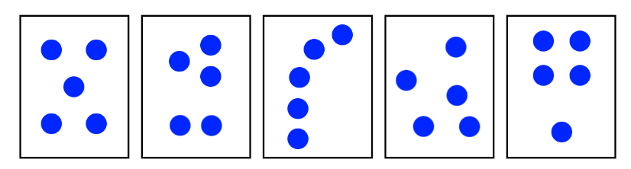

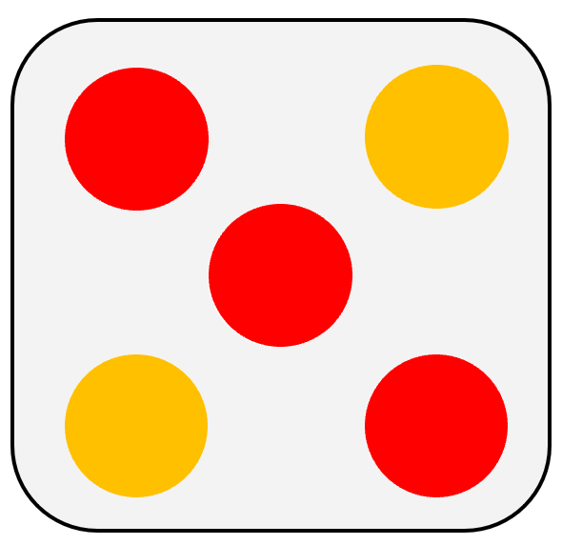

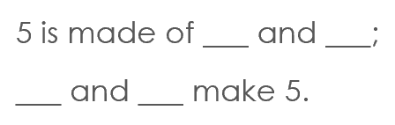

Slide 37
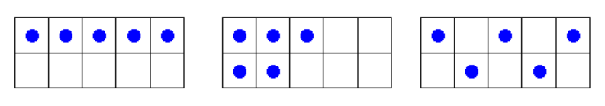
Understanding that the total stays the same even when the objects move
When children first start to use numbers, they often do not understand that if we move objects into another arrangement the total stays the same. We practise this with many different types of objects but a useful tool is using a tens frame to be able to move counters around.

Slide 38
Reasoning
Reasoning in maths helps children to be able to explain their thinking, therefore making it easier for them to understand what is happening in the maths they are doing. It helps them to think about how to solve a problem, explain how they solved it and to think about what they could do differently.
examples of reasoning :
• true and false statements eg adding one to a number always makes it smaller
• spotting incorrect maths eg 1, 2, 3, 4, 6, 5, 7, 8, 9, 10
• explaining how we know something or how we worked it out

Slide 39
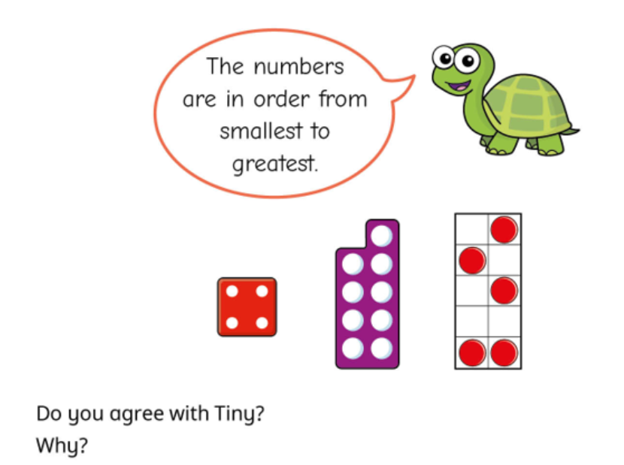

Slide 40
Problem solving
Problem solving in maths allows children to use their maths skills in lots of contexts and in situations that are new to them. It allows them to seek solutions, spot patterns and think about the best way to do things.
In Reception, problem solving might include:
• spotting, following and creating patterns
• estimating amounts of objects
• predicting how many times they can do something in a minute
• sharing objects between different groups – particularly when the amount of groups change and the amount of objects stays the same
• finding different ways to partition numbers eg 5 could be 5+0, 4+1, 3+2 et.

Slide 41
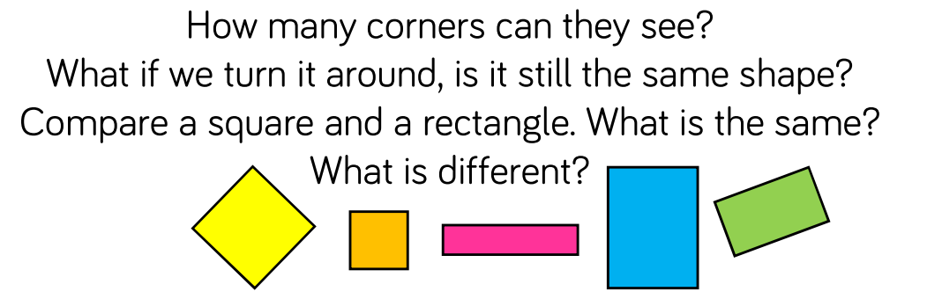
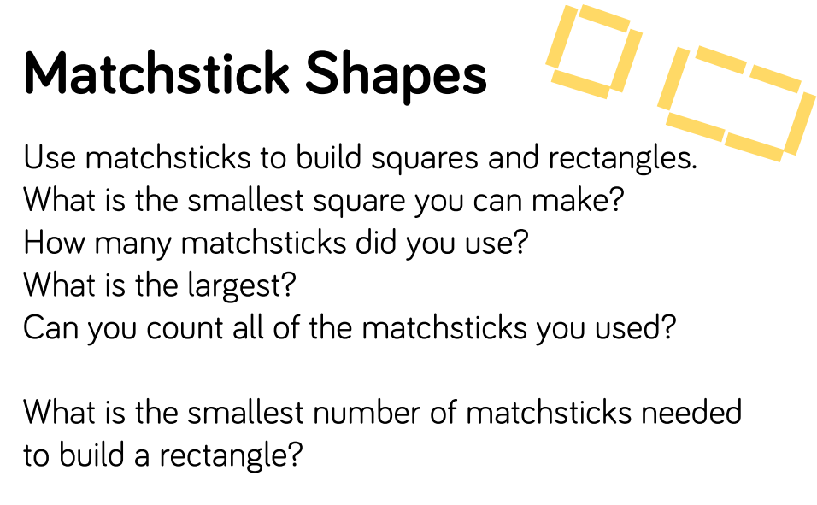

Slide 42
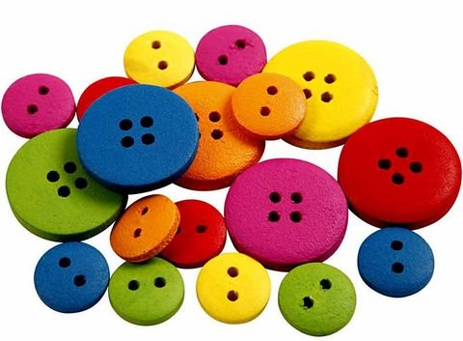
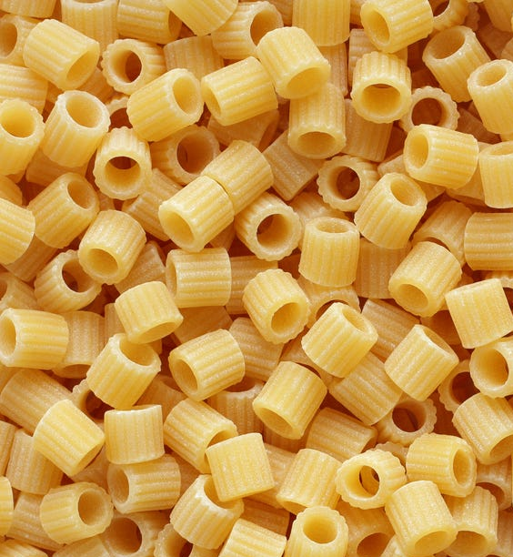
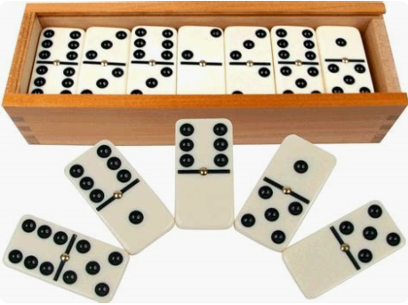
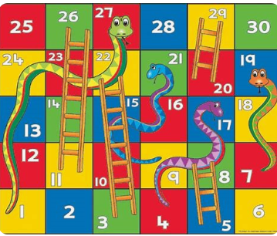
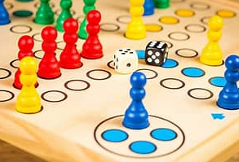
Helping your child with maths
Count- steps up and down the stairs, pennies, buttons, pasta etc. “Can you put 16 carrots in a bag?”
Ask children to say how many without counting (5 or fewer)
Play games using dice/dominoes and encourage child to say how many spots without counting
• Ask children to set the table with enough knives, forks and plates for everyone.
• Spot numbers in the environment – on phones, microwaves, clocks, registration plates, doors.
• Ask children to think of their own representations for numbers eg one of them, two hands, three bears, four wheels on a car, five toes, six sides on a dice, seven dwarves, eight legs on an octopus etc
• Deliberately make mistakes. Children need to understand mistakes are normal and everyone makes them eg get mixed up when counting, muddle two numbers when ordering them.

Slide 43

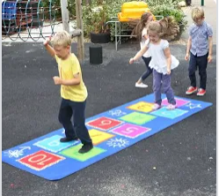

more ideas...
Begin to recall number bonds that make 5 and 10
Dot to dot for number order
Use a calendar to look at dates. “How many days until your birthday?”
Writing numbers in flour, sand, bath, etc
Use numbers written on objects/card with the number of dots to match.
Hide numbers around the house or garden for children to find.
Play outdoor maths games like hopscotch and skittles. Even better, let children make up their own games and decide how to score points.
Read books with maths concepts eg The Very Hungry Caterpillar, One is a snail, ten is a crab, What’s the time, Mr Wolf? The doorbell rang.
Draw attention to more and less.

Slide 44
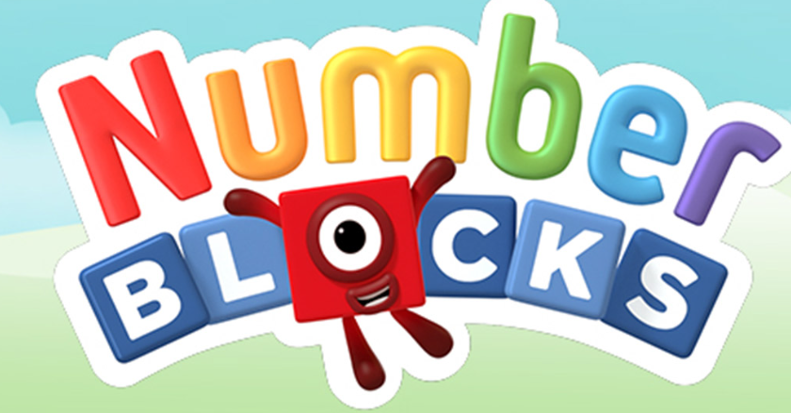
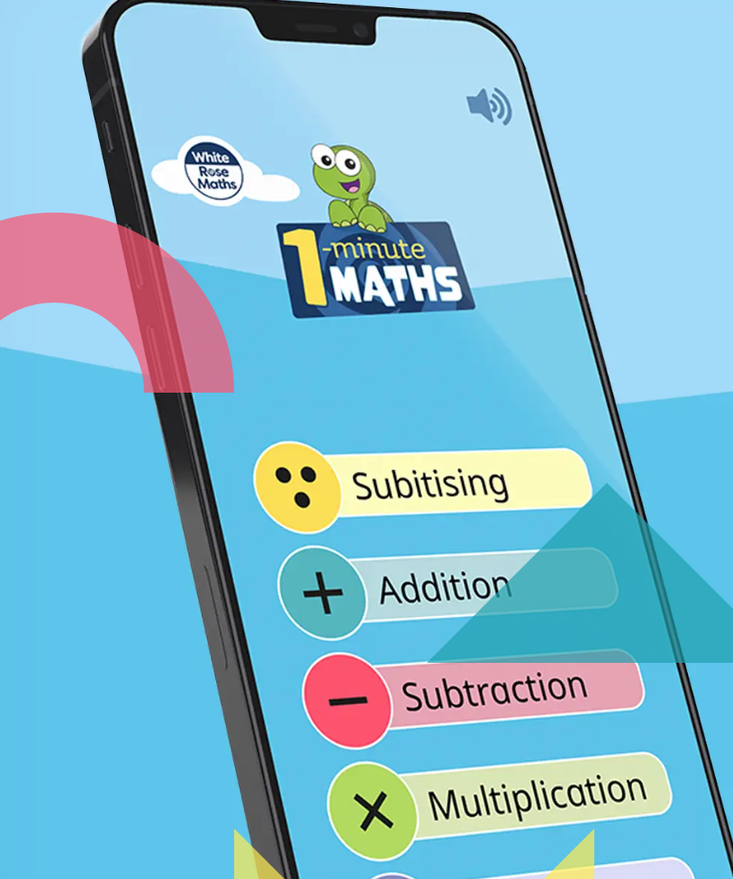


• Watch Numberblocks on Cbeebies. This programme is written by maths specialists to model maths concepts and represents number brilliantly. Also, Numberjacks is excellent for solving problems.

Slide 45
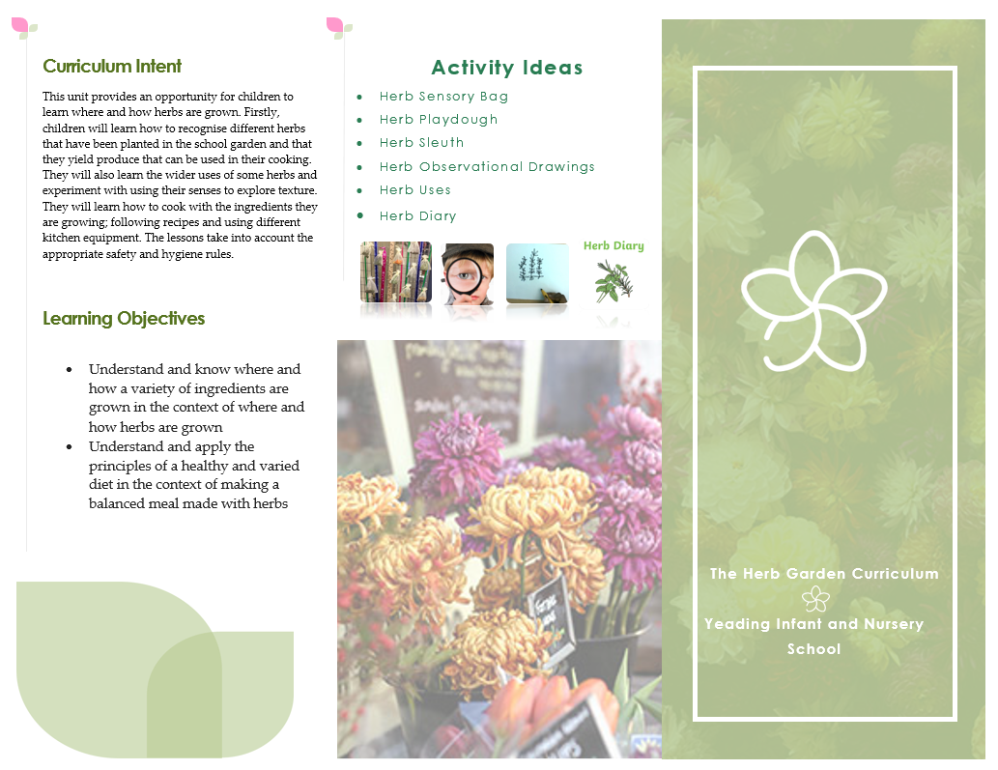
The Great Outdoors
Being outside lets us make big movements, we move our bodies in different ways, solve problems and take risks.
While exploring our natural environment.
The Herb Garden Curriculum
Why is it important?
Builds confidence
Understands pattern
Solve problems
Use technology

Slide 46
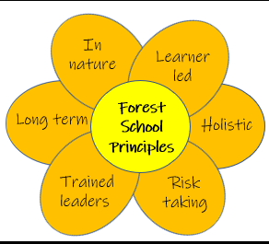
Outdoor learning
Learning outdoors can be enjoyable, creative, challenging and adventurous. It is very important in helping children to learn by experience, grow into confident and responsible citizens.
Recent studies have highlighted benefits of outdoor learning for young children such as:
Higher levels of language
Greater independence
Improved health and sleeping patterns (No matter the weather!!)
Greater physical ability
Improved time and focus on activities through concentration
A greater understanding of nature and the environment
Improved social skills, involvement and initiative
A respect for others and things around them

Slide 47
Understanding of the World
People and Communities
Know the difference between now and the past .
Understand different people have different beliefs.
Understand why we need to treat each other with respect.

Slide 48
Understanding of the World
The World
To understand the properties of some materials.
To understand some of the uses for materials.
To be familiar with concepts such as floating and sinking.
Understand living things and the environment.
Understand how humans effect living things and the environment
How to look after our community

Slide 49
Understanding of the world
Technology
Use a range of everyday technology e.g. computers, CD players, digital cameras, tape recorders, IPad,
Select appropriate applications/programs

Slide 50

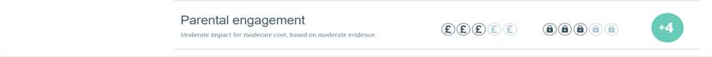
How can you help at home?
☺
Ask open-ended questions (Why? What? How? When? Where?)
Encourage children to think of solutions (How can we make this work?)
Encourage children to talk about their experiences (what they see, hear, smell, touch and taste)
Encourage children to discuss similarities and differences of the world around them
Helping children to become aware of the importance of recycling, reusing and reducing
Encourage healthy eating habits
Promoting cultural diversity

Slide 51
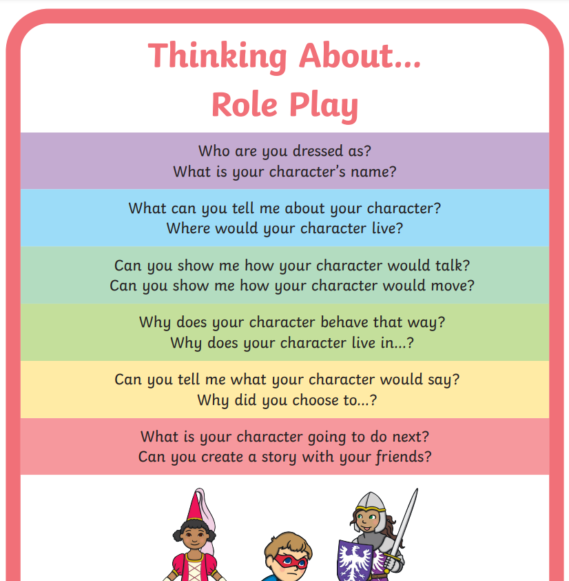

Slide 52
Expressive Arts & Design
Taking risks
Initiating their own learning
Making choices and decisions
Finding ways to express their unique experiences
Explore media and materials
Create the most weird and wonderful things

Slide 53

Expressive Arts & Design
We need to:
Provide a stimulating environment
Provide a wide variety of resources
Provide opportunities
Encourage ‘have a go’ and take risks
Encourage different forms of communication and expression
Value every effort and discuss next steps
https://www.firstdiscoverers.co.uk/early-years-painting-activities-ideas/

Slide 54
Our Website
http://yeadinginf.co.uk/
Our Instagram
https://instagram.com/yeading_infants
Please take part in our Parent and Carer Surveys throughout the year!

Slide 55
Thank you all for listening
We hope you will take this experience and provide exciting learning opportunities environment for your children, both inside and outside of the home environment.

Slide 56
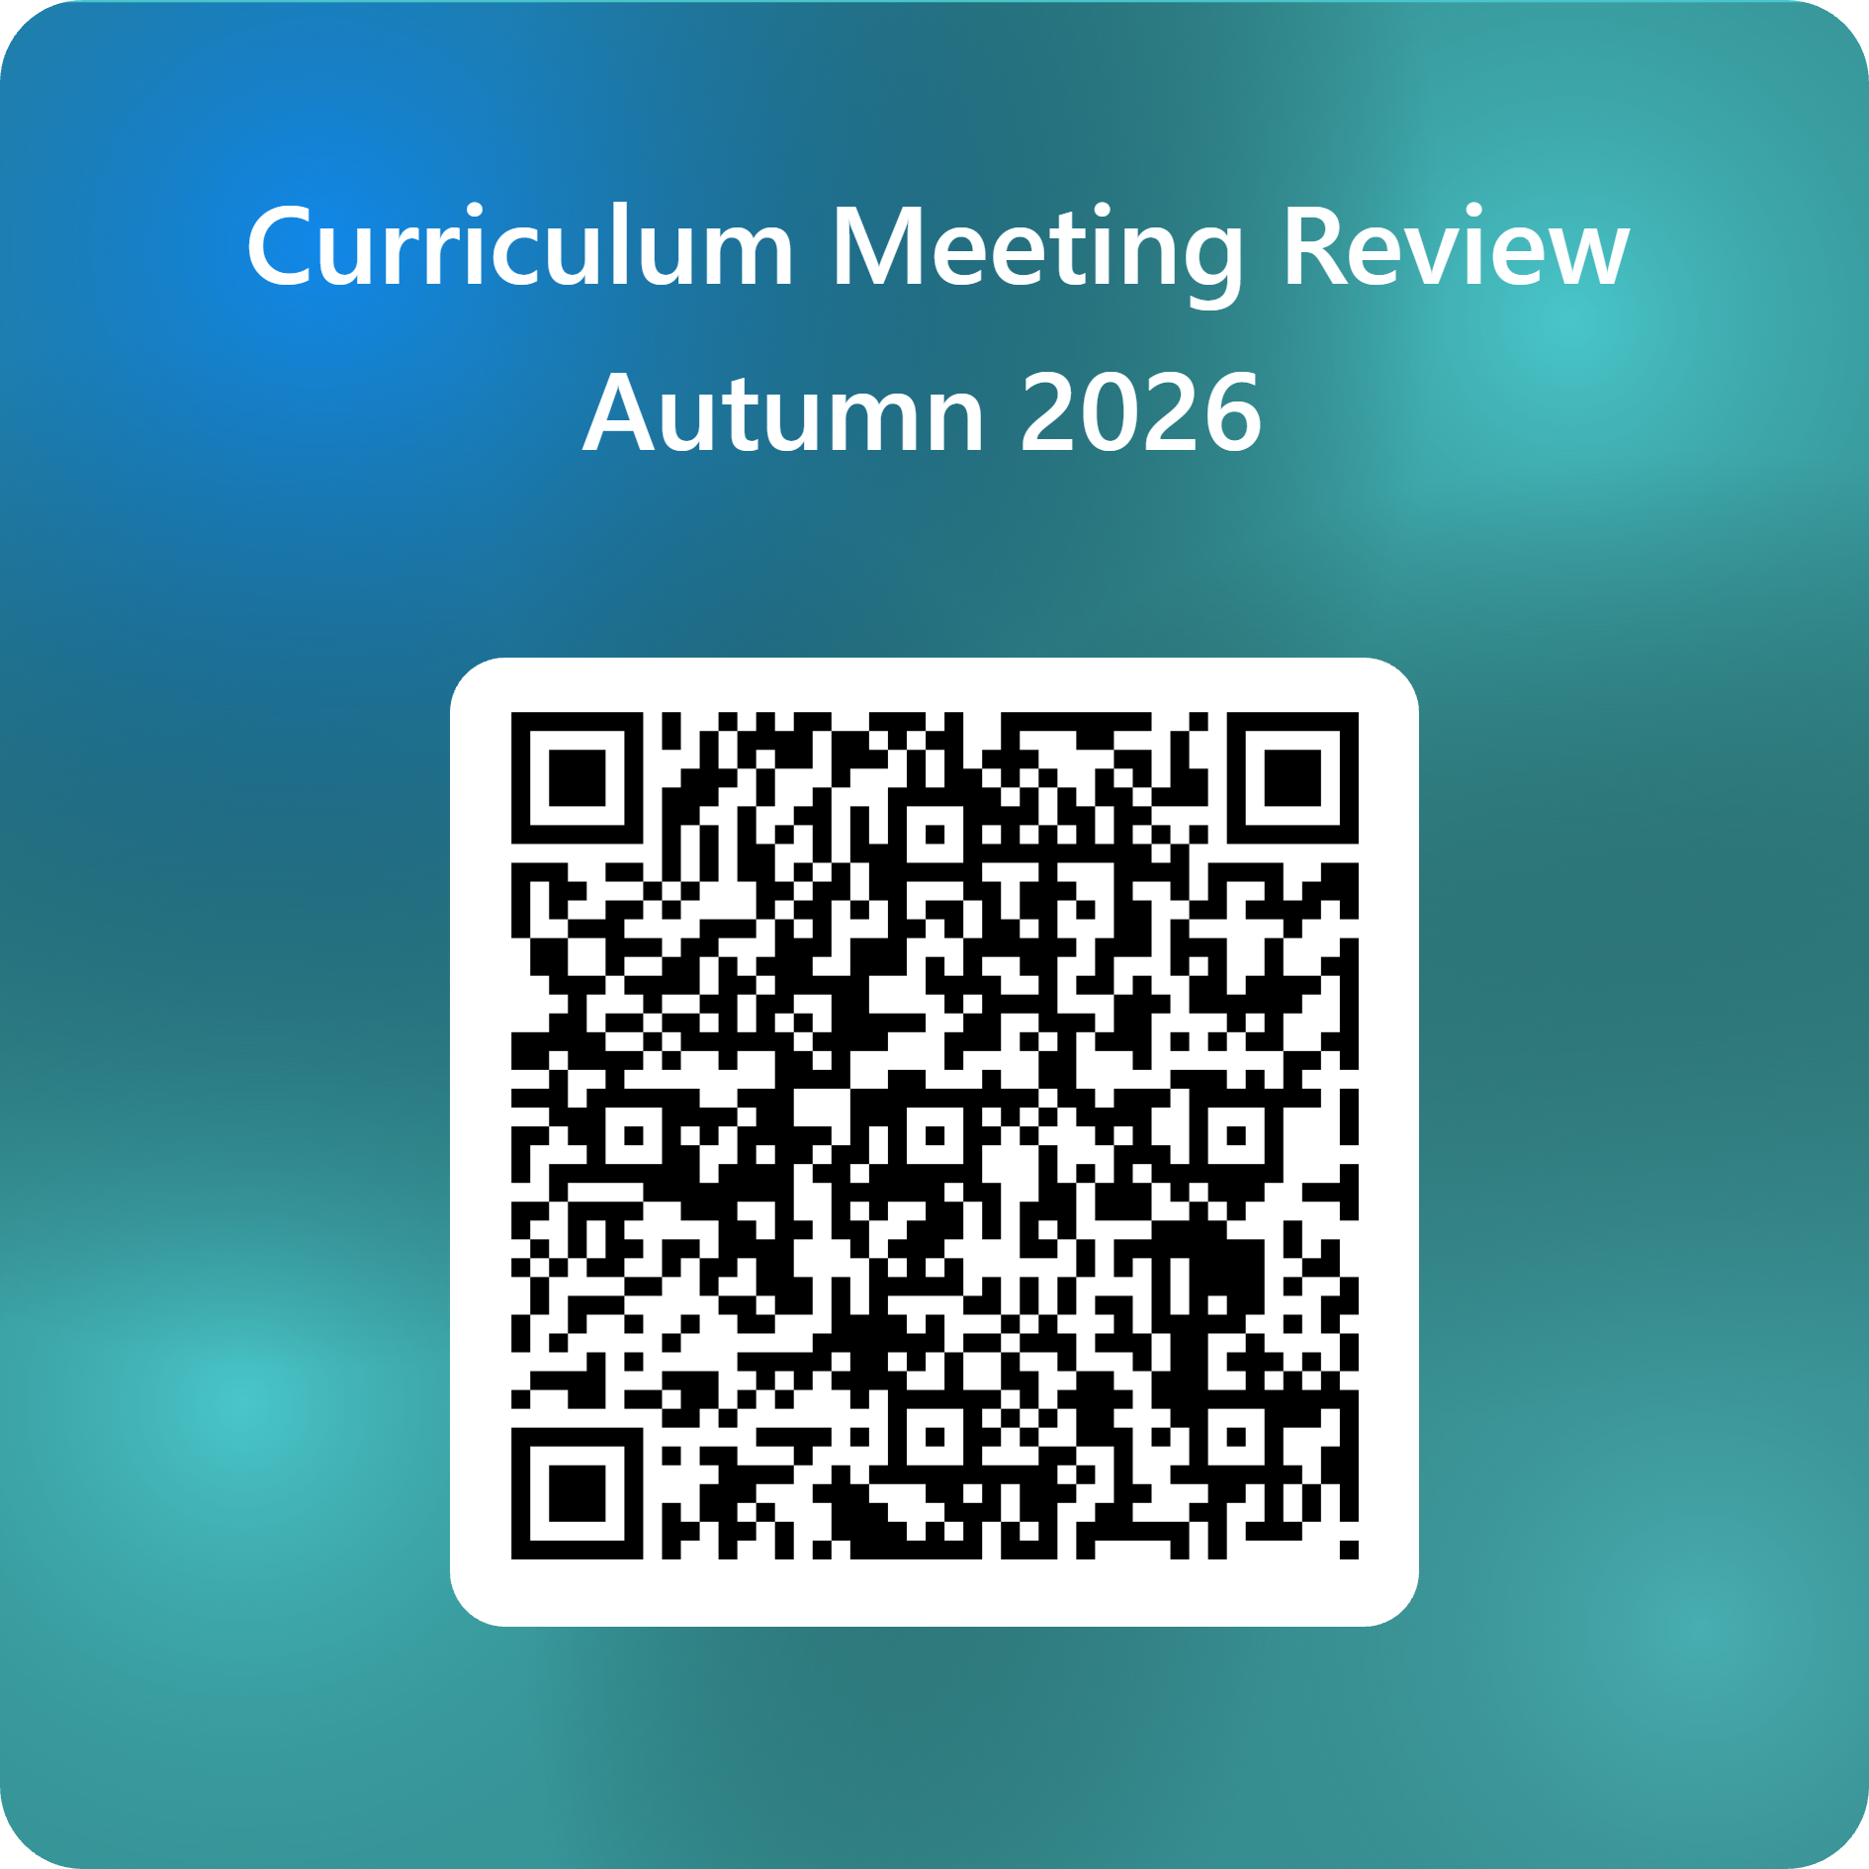
Please fill in parent questionnaire.
Thank you

