Slide 1
Supporting children in Reception with their writing
Miss Semi
November 2023
Notes:
Introduce myself

Slide 2
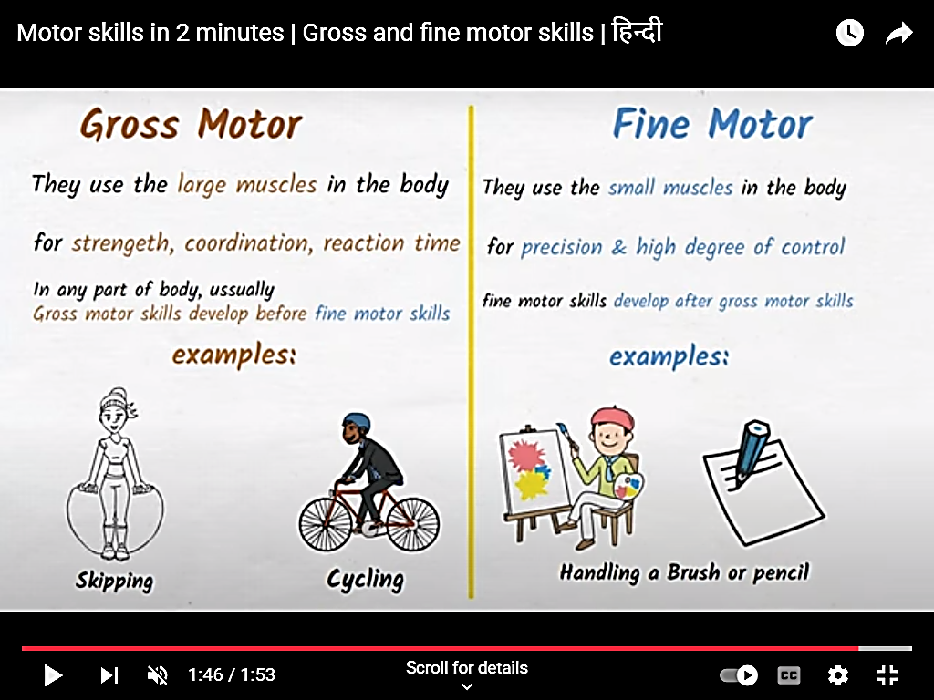
First steps
Muscles in hands/fingers – activities to develop these
e.g. bead threading, tongs and marbles, building with small pieces of lego, fastening buttons, turning pages in a book
Pencil grip
Tri grip pencils to support correct grip
Tracing straight and wavy lines
Notes:
Fine motor skills need to develop to aid writing

Slide 3
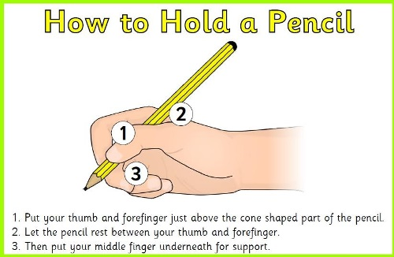
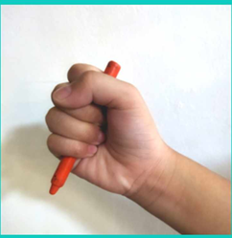
Developing grip

Slide 4
Cursive Formation
Every lower case letter starts from the bottom.
Cursive handwriting: how to write the alphabet
Notes:
If possible, watch some of the video

Slide 5
Writing at school
Focus writing session - for different purposes
Daily Phonics lesson: Letters & Sounds including high frequency words
Cursive letter formation
Writing their name
Independent writing – words, labels, sentences
Writing outdoors
Developing Stamina:
Letters > words > sentences > paragraphs

Slide 6
Prompts used in school
Say it slowly
What can you hear first?
Say it again/slowly, what can your hear next?
What sound can you hear at the end?
Tell me the sounds in that word?
How many sounds are there in that word?
Phoneme frame, dot and line

Slide 7
Questions to ask
Children should know the difference between a letter, a sound and a word.
After reading their book, you could ask them:
How many words are there in that sentence?
How many letters are there in the first word?
How many sounds are there in that word?

Slide 8
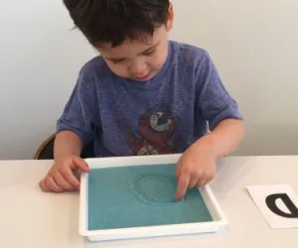
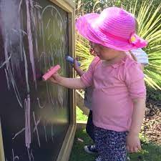
Writing tools
Pencils
Coloured felt tips
Paint
Water and paint brush
Aqua doodle
Sand
Whiteboard and marker
Blackboard and chalk

Slide 9
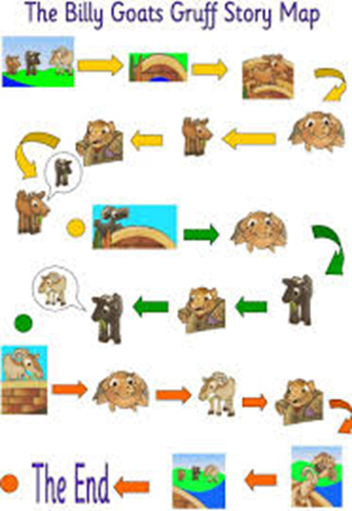
Talk for Writing
If they don’t hear stories, they can’t tell stories. If they can’t tell stories, they can’t write stories.
Story maps for oral rehearsal and writing
Story map for every half term will be sent home so you can support your child at home with learning the story.

Slide 10
Early Learning Goal - Writing
Write recognisable letters, most of which are correctly formed.
• Spell words by identifying sounds in them and representing the sounds with a letter or letters.
• Write simple phrases and sentences that can be read by others.

Slide 11
Explanatory notes
The child writes for a range of purposes in meaningful contexts. The child’s writing may include features of different forms such as stories, lists, labels, captions, recipes, instructions and letters. The child’s writing is phonetically plausible when he or she writes simple regular words and particularly when he or she attempts to write more complex words. The child and others can read and make sense of the text.

Slide 12
Early Learning Goals
Emerging - Not yet reached the Early Learning Goal (ELG)
Expected - Expected level at the end of Reception
Children working at lower end will also be appropriately supported and will work on a different assessment frame work. Those working above this will be appropriately challenge within the classes.

Slide 13
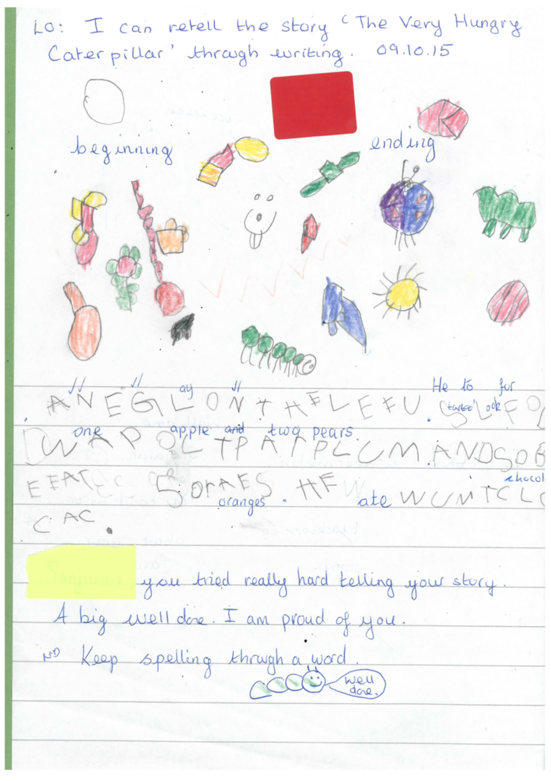
Emerging

Slide 14
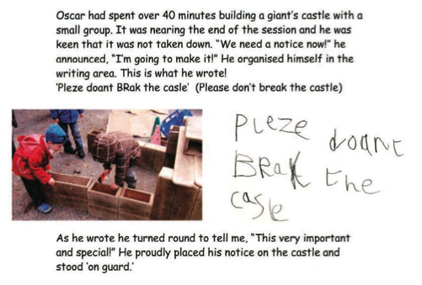
Examples of writing at ‘expected’ level

Slide 15
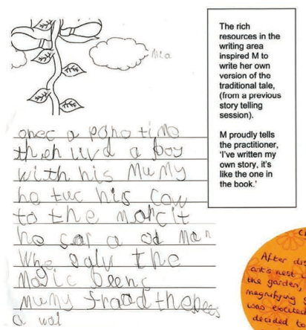
Expected

Slide 16
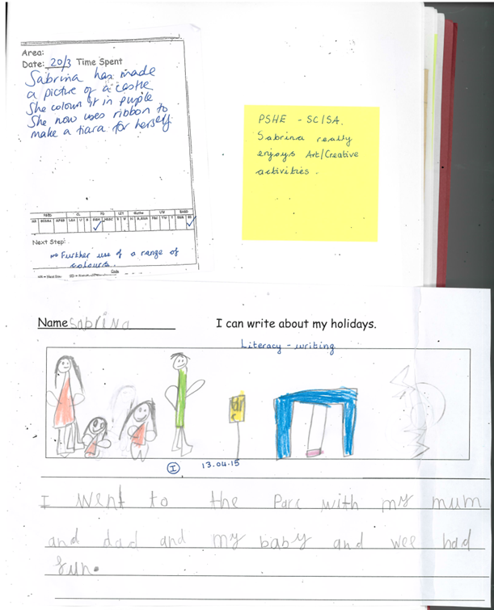
Expected

Slide 20
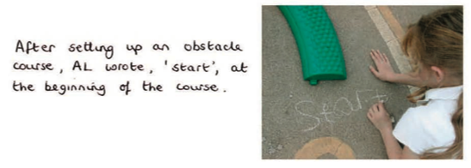
Writing for different purposes

Slide 21
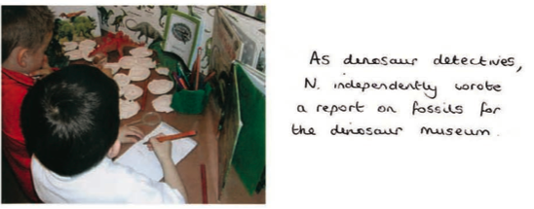
Writing for different purposes

Slide 22
Writing at home
Write for a range of purposes:
Birthday/Christmas cards
Letters e.g. to a friend/Father Christmas
Thank you notes
Shopping list
Invitations
Instructions/Recipes
Whiteboards

Slide 23
Writing at home
Encourage your child to sound out the words that can be spelt phonetically.
Help them to spell the high frequency words in Phases 2-4 of Letters and Sounds.
Praise and encourage at every opportunity.
Encourage cursive letter formation
Talk to them and encourage them to talk at every opportunity.
Weekly newsletter for further information

Slide 24
Prompts to use at home
Say it slowly
What can you hear first?
Say it again, what can your hear next?
What sound can you hear at the end?
Tell me the sounds in that word?
How many sounds are there in that word?
Phoneme frame, dot and line

Slide 25
Thank you for your support.

